Slide 1
thank you all
as always
Notes:
thank you for not dropping the class:)
truly appreciate your support

Slide 2
Fundamentals of Computer Design - Basics
02
Kai Bu
kaibu@zju.edu.cn
http://list.zju.edu.cn/kaibu/comparch2019
Notes:
In today’s lecture, we will warm up with computer design basics

Slide 3
Fundamentals of Computer Design - Basics
which types of computers?
why are computers so fast?
what is computer architecture?
Notes:
such as computer classes, major techniques for fast computation, and the definition of computer architecture.
Only after we know in what ways we are evaluating computer performance can we know what to guarantee and improve upon designing computer architecture

Slide 4
too many
concepts ahead
Notes:
An overview chapter, so many concepts to unfold

Slide 5
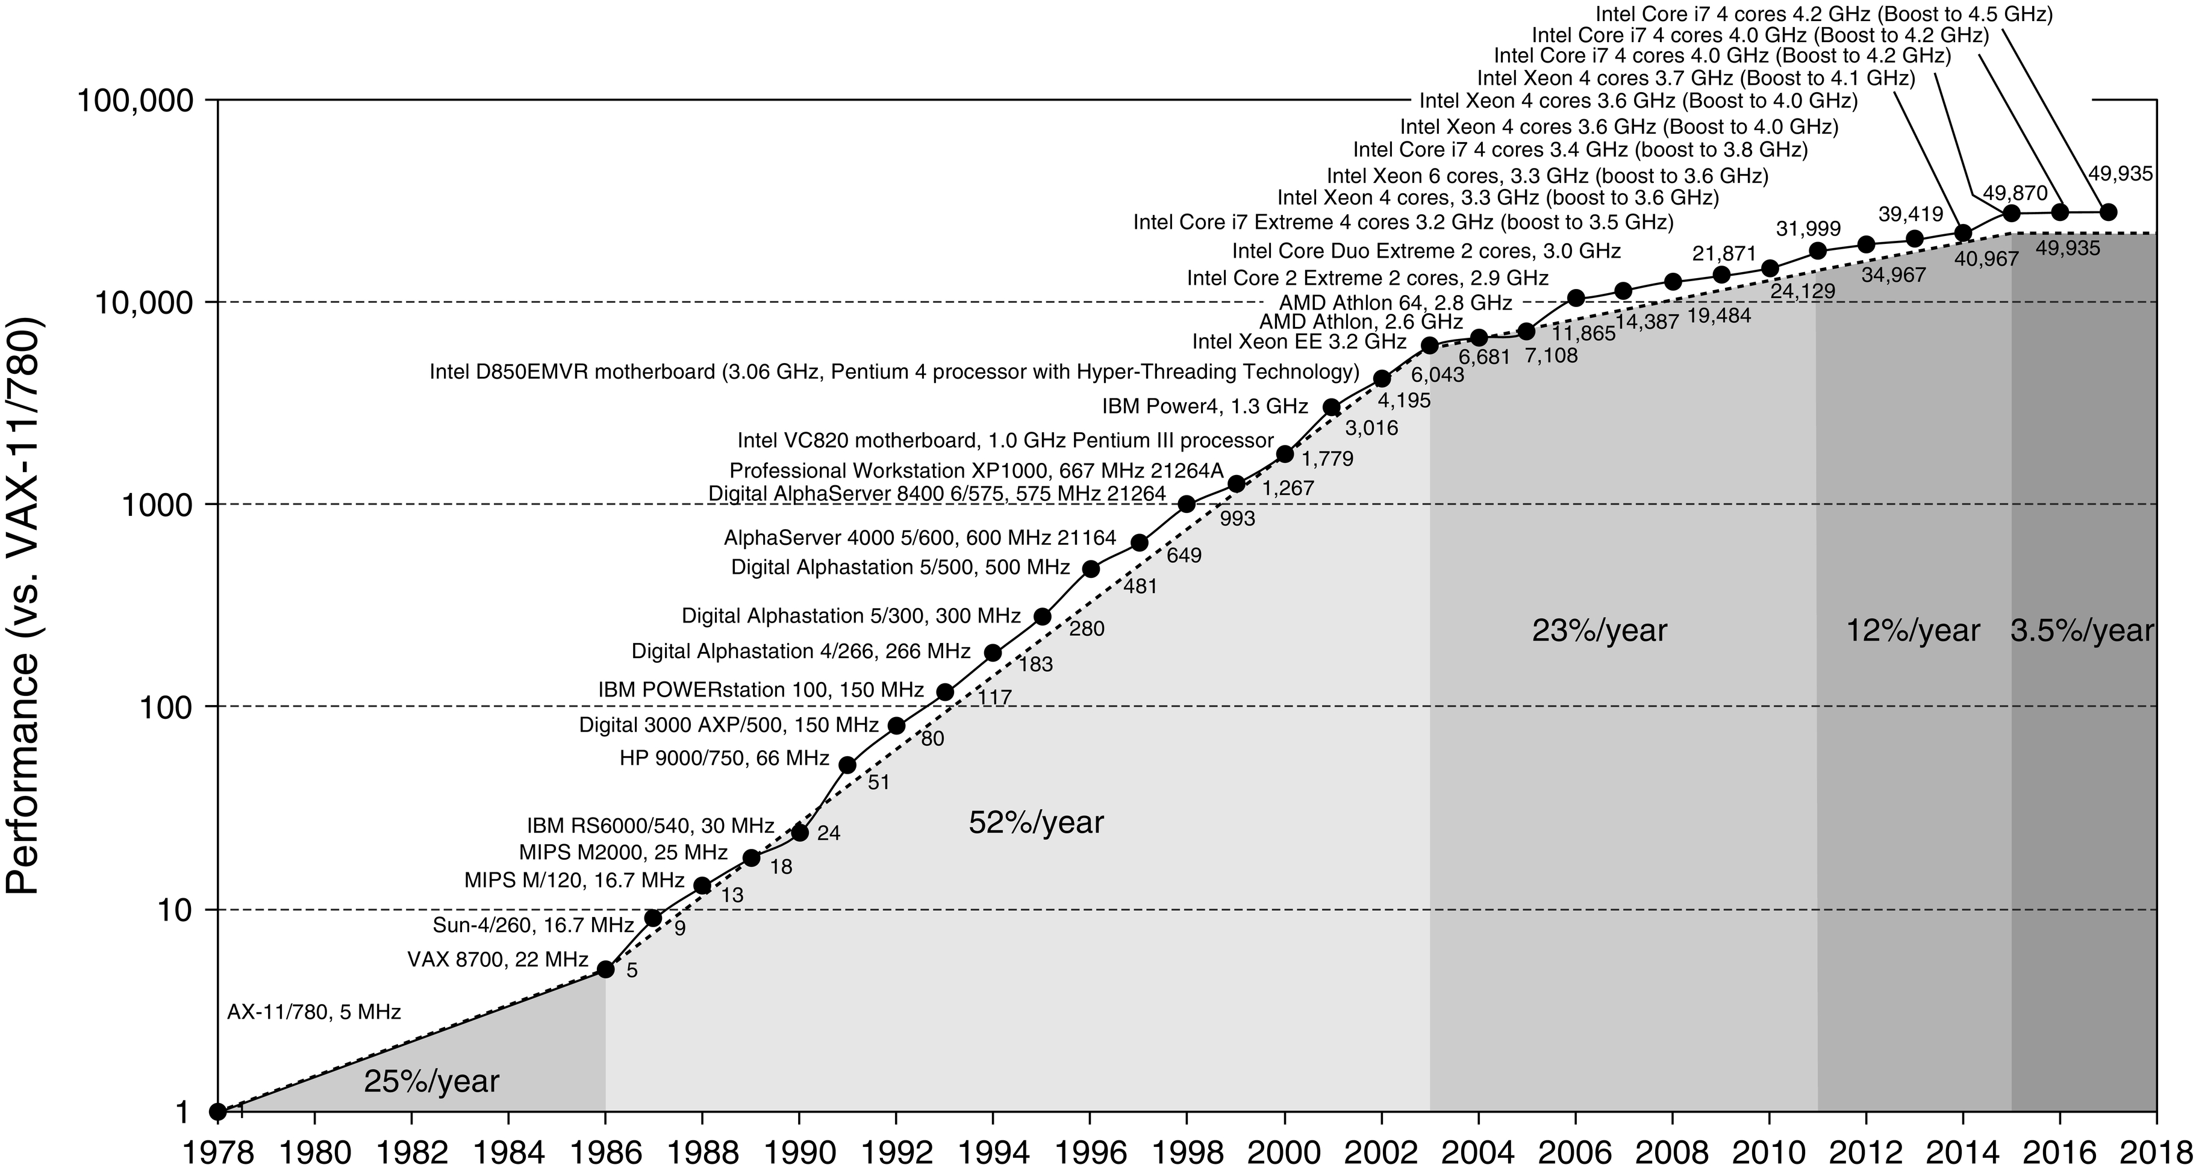
Processor Perf Growth:
A 40-Year Lookback
Notes:
The ultimate goal of this course is to understand techniques that keep improving processor performance.
Before unfolding the mystery, let’s take a 40-year lookback at the growth of processor performance.

Slide 6
Processor Perf Growth:
A 40-Year Lookback
Moore’s Law
Dennard Scailing
Notes:
As shown in this figure, an unprecedented growth rate of over 50% consecutively lasted for about 17 years, from 1986 to 2003.
(The combination of architectural and organizatioal enhancements led to 17 years (1986-2003) of sustained growth in performance at an annual rate over 50%, a rate that is unprecedented in the comptuer industry.)
Two profound laws were well accepted for profiling the growth rate, Dennard scaling and Moore’s Law; both of which have already been out of date.

Slide 7
Dennard Scaling
Power density is constant for a given area of silicon even as you increase the number of transistors because of smaller dimensions of each transistor
Ended around 2004 because current and voltage couldn’t keep dropping and still maintain the dependability of integrated circuits
Notes:
So, as transistors get much smaller, turns out to need more power, cause each tiny transistor needs sufficient power for dependability

Slide 8
Moore’s Law
The nubmer of transistors per chip would double every year, as predicted in 1965, which was amended in 1975 to every two years
Ended around 2015
Notes:
The other law is the Moore’s Law;
Given the same chip size and lower bound of transistors, the number of transistors per chip cannot always increase;

Slide 9
Multi-Core Processor
Multiple efficient processors instead of a single inefficient processor
From instruction-level parallelism to data-level and thread-level parallelism
Notes:
These changes force the microprocessor industry to use multiple efficient processors or cores instead of a single inefficient processor
This milestone signaled a historic switch from relying solely on instruction-level parallelism to data-level parallelism and thread-level parallelism

Slide 10
Amdahl’s Law
Multi-core parrallelism requires the restructuring of the application, a major new burden for programmers
Speedup Effect: Amdahl’s Law
Notes:
However, DLP, TLP, and request-level paral require the restructuring of the application, a major new burden for programmers
To what extent can parallelism speed up program?
Quantified by Amdahl’s Law: Equation

Slide 11
Amdahl’s Law
Multi-core parrallelism requires the restructuring of the application, a major new burden for programmers
Speedup Effect: Amdahl’s Law
limit:
1/(1-Fraction_{enhanced})
so not too many cores
Notes:
However, DLP, TLP, and request-level paral require the restructuring of the application, a major new burden for programmers
To what extent can parallelism speed up program?
Quantified by Amdahl’s Law: Equation
It prescribes practical limits to the number of useful cores per chip.
Example: If 10% of the task is serial, then the maximum performance benefit from parallelism is 10 no matter how many cores you put on the chip

Slide 12
What types of computers?
Notes:
Since all our discussions in this course will relate to computers, then what kinds/types of computers do you know or have? Any examples?

Slide 13
5 Classes of Computers
PMD: Personal Mobile Device
Desktop
Server
Cluster/WSC (warehouse-scale computer)
Embedded/IoT computer
Notes:
Good examples; All those computers you’ve just mentioned fall into these five classes.
The first one is personal mobile device.

Slide 14
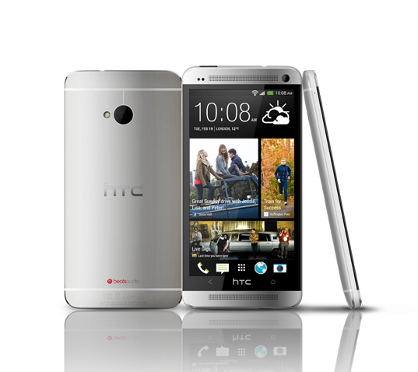
PMD: Personal Mobile Device
Wireless devices with multimedia user interfaces
cell phones, tablet computers, etc.
a few hundred dollars
Notes:
Personal mobile devices, such as smartphones and tablets, are the most pervasive computers nowadays.
They have small size, high portability, yet low cost.

Slide 15
PMD Characteristics
Cost effectiveness
less expensive packaging
absence of fan for cooling
Notes:
In comparison with more expensive computers like pcs or laptops,
PMD’s low cost owes to their less expensive packaging and absence of fan for cooling.

Slide 16
PMD Characteristics
Responsiveness & Predictability
real-time performance:
a maximum execution time for each
application segment
Notes:
The expectation for PMD’s responsiveness is that it should satisfy real-time performance constraint.
For this, a segment of the application has an absolute maximum execution time.
For example, in playing a video on a PMD, the time to process each video frame should be limited, since the processor must accept and process the next frame shortly.
However, real-time performance is a very strict requirement; it’s hard to satisfy.

Slide 17
PMD Characteristics
Responsiveness & Predictability
real-time performance:
a maximum execution time for each
application segment
soft real-time:
trade time of a certain event for others’;
tolerate occasionally missed time constraint on an event,
as long as not too many are missed;
Notes:
As an alternative, some applications choose soft real-time performance,
which tolerates occasionally missed time constraint on an event, as long as not too many are missed.

Slide 18
PMD Characteristics
Memory efficiency
optimize code size
Energy efficiency
battery power
heat dissipation
Notes:
For PMD, Memory can be a substantial portion of the system cost; We need to economize memory usage. PMD hosts various applications and thus large volume of code; so we can optimize code size toward memory efficiency;
Besides, PMD also has limited power and has no fan for cooling; so economizing battery usage and heat dissipation technique are key to save energy;

Slide 19
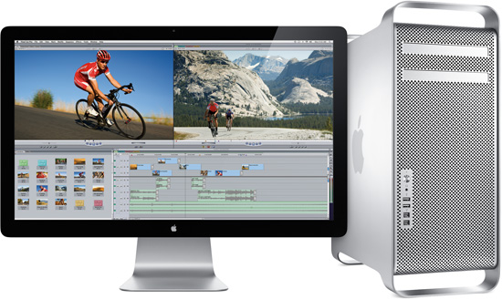
Desktop Computing
Largest market share
low-end netbooks: $x00
high-end workstations: $x000
Notes:
Desktops and laptops take largest market share and are most familiar to us.
They range from low-end netbooks to high-end workstations.
They usually cost hundreds to thousands of dollars

Slide 20
Desktop Characteristics
Price-Performance
combination of performance and price;
compute performance
graphics performance
The most important to customers,
and hence to computer designers
Notes:
Desktops deliver high performance but cost affordable prices.
So they are the most important to customers and hence to computer designers.

Slide 21
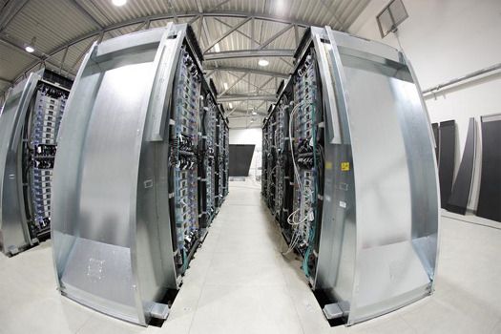
Servers
Provide large-scale and reliable file and computing services (to desktops)
Constitute the backbone of large-scale enterprise computing
Notes:
Servers aim to provide large-scale and reliable file and computing services to desktops connected to them.
They constitute the backbone of large-scale enterprise computing.

Slide 22
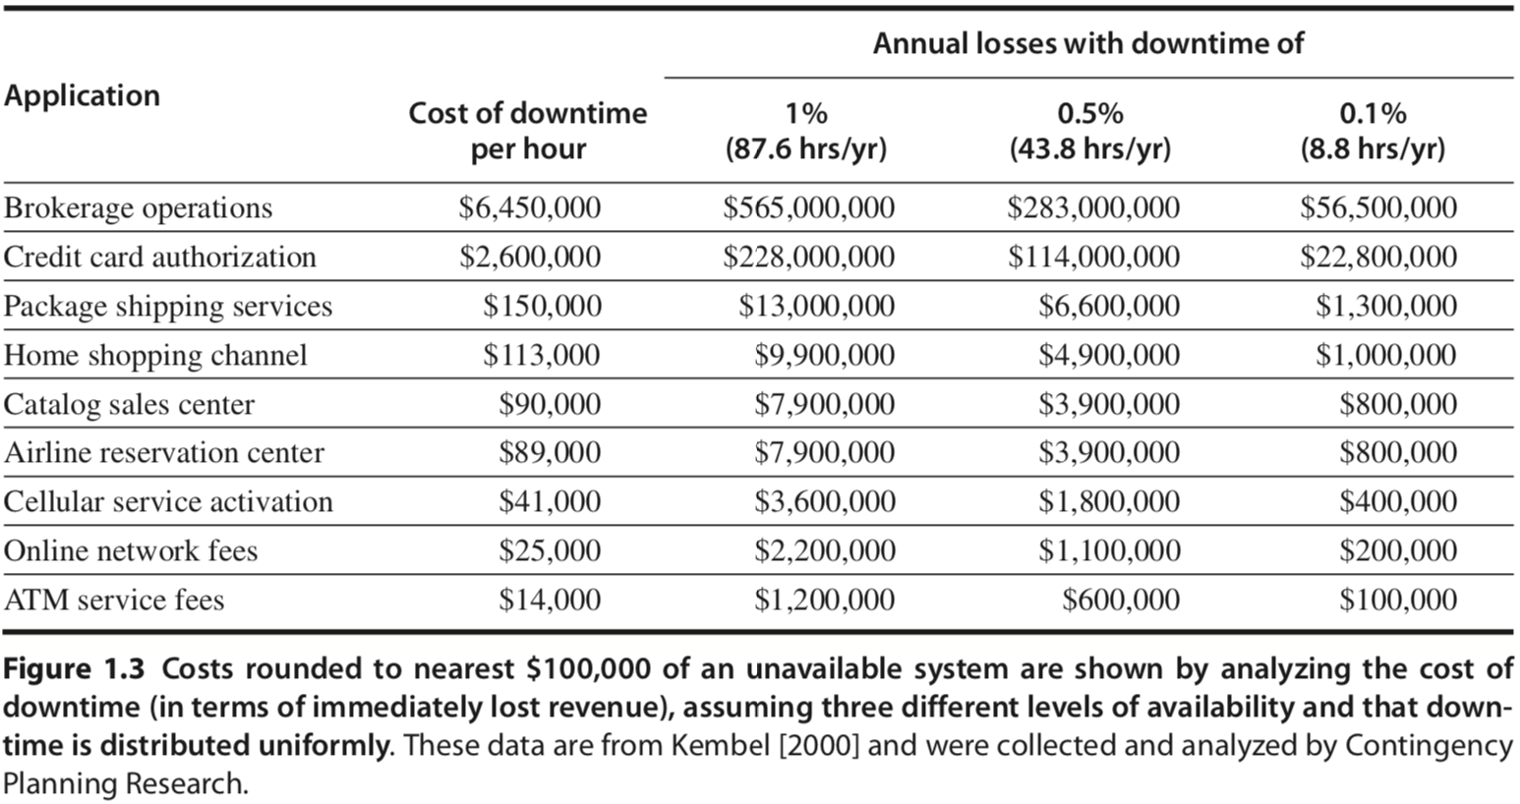
Servers Characteristics
Availability
against high-cost server failure
Notes:
The major character of servers should be high availability, as server down usually costs a lot to hosting services.
For some critical network services like credit card authentication and ATM operations, server failure comes at too high a cost.

Slide 23
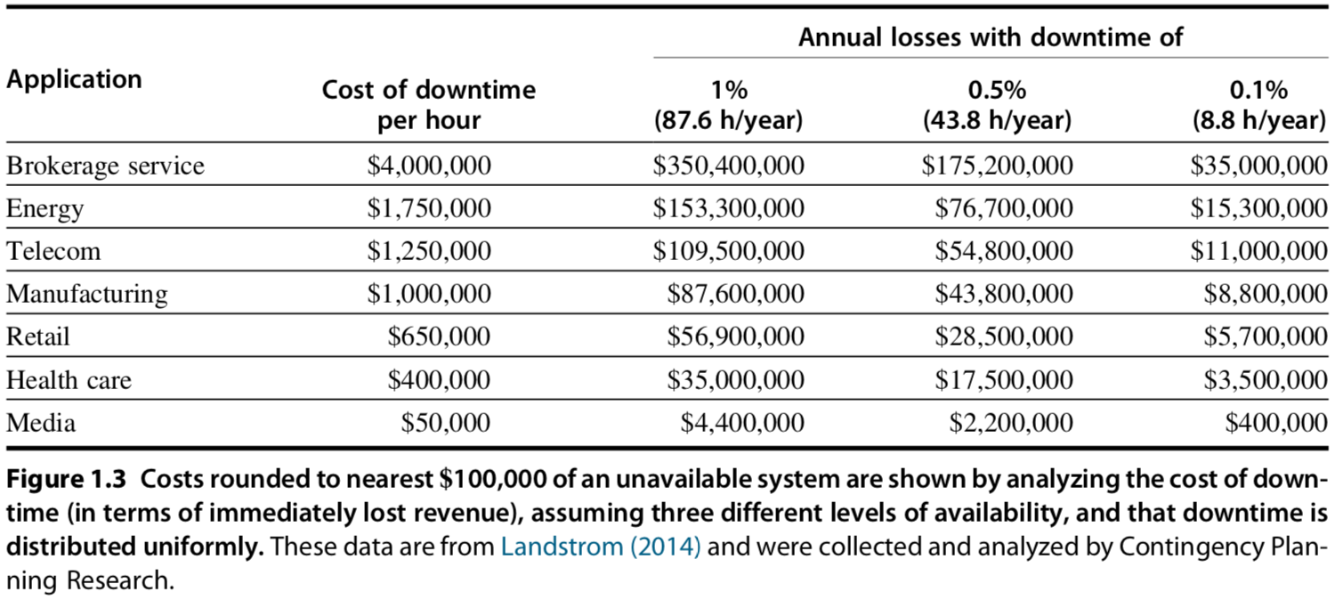
Servers Characteristics
Availability
against high-cost server failure
updated version
Notes:
The major character of servers should be high availability, as server down usually costs a lot to hosting services.
For some critical network services like credit card authentication and ATM operations, server failure comes at too high a cost.

Slide 24
Servers Characteristics
Scalability
in response to increasing demand with scaling up computing capacity, memory, storage, and I/O bandwidth
High throughput
handling more requests in a unit time:
in terms of transactions per minute or web pages served per second
Notes:
Servers should also be scalable, that is, they should be capable of handling a large volume of service requests.
Toward this, it might need to enhance computing and storage capacity.
We also expect that servers have high throughput, that is, handling more requests in a unit time.

Slide 25
Clusters/WSCs
Warehouse-Scale Computers
collections of desktop computers or servers
connected by local area networks (LANs)
to act as a single larger computer
Characteristics
price-performance, availability, power
Notes:
Clusters are also known as werehouse-scale computers; they are collections of pcs/servers
Then the connected computers can act as a single larger computer.
Its Characteristics are similar to its components, that is, desktop and server: which are, for example, price-performance and availability
Besides, since it consists of a bunch of computers altogether, we need to economize its power consumption;

Slide 26
Clusters/WSCs
(Difference from) Supercomputers
emphasize floating-point performance;
run large, communication-intensive batch programs that can run for weeks at a time;
WSCs
emphasize interactive applications, large-scale storage, dependability, and high Internet bandwidth
Notes:
Supercomputers are related to WSCs in that they are equally expensive, costing hundreds of millions of dollars, but supercomputers differ by emphasizing floating-point performance and by running large, communication-intensive batch programs that can run for weeks at a time.
In contrast, WSCs emphasize interactive applications, large-scale storage, dependability, and high Internet bandwidth.

Slide 27
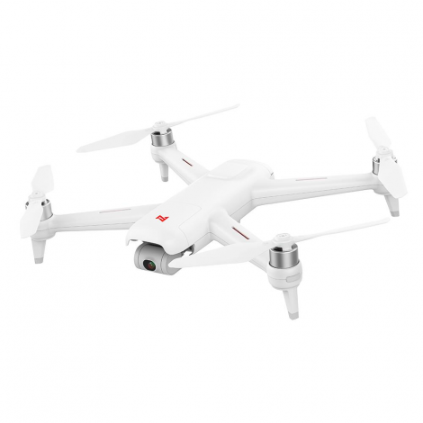
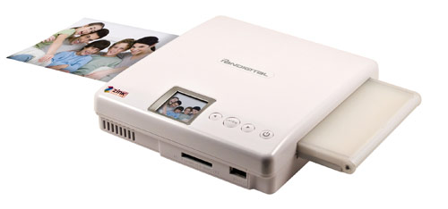
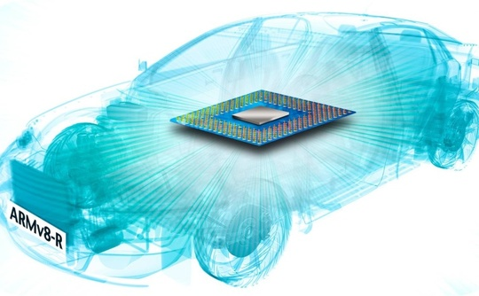
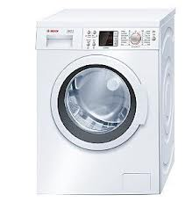
Embedded Computers
hide everywhere
Notes:
Embedded computers just hide everywhere. They are in cameras, washing machines, drones, and even our cars/automobiles.

Slide 28
Embedded Computers
Internet of Things (IoT)
connected to Internet wirelessly
Notes:
The phrase of Internet of Things (IoT) refers to embedded computers that are connected to the Internet, typically wirelessly.
The projections for the number of IoT devices in 2020 range from 20 to 50 billion.

Slide 29
Embedded vs Non-embedded
Dividing line:
the ability to run third-party software
Embedded computers’ primary goal:
meet the performance need at a minimum price;
rather than achieve higher performance at a higher price
Notes:
How can we differ embedded computers from non-embedded ones?
The key clue is whether a computer got the ability to run third-party software.
After all, embedded computers are made to meet the performance need at a minimum price
rather than achieve higher performance at a higher price.
Any questions?

Slide 30
Summary & Comparison

Slide 31
Summary & Comparison
performance matters

Slide 32
What makes computers fast?
Notes:
What makes these types of computers so fast?
Any ideas?

Slide 33
Parallelism
Multi-task simultaneously takes effect
application parallelism
hardware parallelism
Notes:
The answer is parallelism, it makes multiple tasks to simultaneously take effect;
We can explore parallelism in both application layer and hardware layer.

Slide 34
Application Parallelism
DLP: Data-Level Parallelism
many data items being operated on
at the same time
TLP: Task-Level Parallelism
tasks of work created to operate independently and largely in parallel
*parallelization across multiple processors
in parallel computing environments
Notes:
For application parallelism, we have data-level parallelism and task-level parallelism.
DLP operates many data items at the same time; (example: addition computation)
TLP creates tasks of work such that they operate independently and largely in parallel.
Both parallelisms strive for parallelization across multiple processors in parallel computing environments

Slide 35
Application Parallelism
DLP: Data-Level Parallelism
many data items being operated on
at the same time;
distribute the same data across different processors;
Notes:
Essentially, DLP focuses on distributing the data across different processors, which operate on the data in parallel.

Slide 36
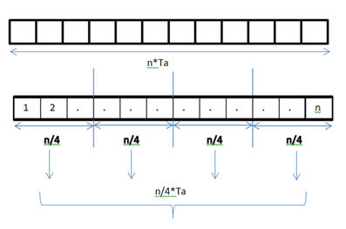
Application Parallelism
DLP: Data-Level Parallelism
many data items being operated on
at the same time;
distribute the same data across different processors;
Example 1:
add elements in an array;
each addition takes Ta time units;
1 processor vs 4 processors

Slide 37
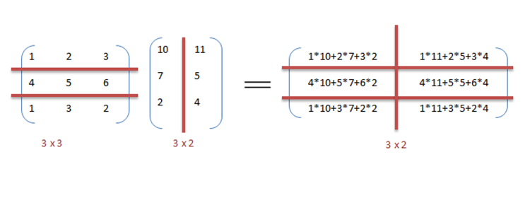
Application Parallelism
DLP: Data-Level Parallelism
many data items being operated on
at the same time;
distribute the same data across different processors;
Example 2:
matrix
multiplication
1 processor vs 6 processors

Slide 38
Application Parallelism
TLP: Task-Level Parallelism
tasks of work created to operate independently and largely in parallel;
run many different tasks at the same time on the same data;
Example:
input a bitstring to two processors;
processor A counts bit 0 or 1;
processor B computes its complement;
Notes:
In contrast to data level parallelism that runs the same task on different components of data, TLP runs many different tasks at the same time on the same data.

Slide 39
Hardware Parallelism
Hardware exploits app parallelism
in four ways:
ILP: Instruction-Level Parallelism
Vector Architectures, GPUs, and MM
TLP: Thread-Level Parallelism
RLP: Request-Level Parallelism
Notes:
For hardware parallelism, we have four possible ways.
(Vector Architectures, GPUs - Graphic Process Units, and MM – Multimedia Instruction Sets)
The first one is instruction-level parallelism.

Slide 40
Hardware Parallelism
ILP: Instruction-Level Parallelism
exploits data-level parallelism
at modest levels – pipelining
divide a task to steps;
simultaneously run different steps
of different tasks.
at medium levels – speculative execution
do some work in advance;
prevent delay when the work is needed.
Notes:
Instruction-level parallelism exploits data-level parallelism;
At modest levels, it works through pipelining. Pipelining is the most important topic of our lecture and lab sessions.
It divides a task to steps, and then simultaneously runs different steps of different tasks.
At medium levels, instruction-level parallelism works through speculative execution. It runs some task in advance in order to prevent delay when the task’s result is needed.

Slide 41
Hardware Parallelism
Vector Architectures & GPUs & Multimedia Instruction Sets
exploit data-level parallelism;
apply a single instruction to a collection of data in parallel;
Notes:
Vector architectures and GPUs also exploit data-level parallelism; it applies a single instruction to a collection of data in parallel.

Slide 42
Hardware Parallelism
TLP: Thread-Level Parallelism
exploits either DLP or TLP,
in a tightly coupled hardware model
that allows for interaction among parallel threads;
Notes:
On the other hand, thread-level parallelism exploits either data-level parallelism or task-level parallelism.
It aims for tightly coupled hardware model that allows for interaction among parallel threads.

Slide 43
Hardware Parallelism
RLP: Request-Level Parallelism
exploits parallelism among
largely decoupled tasks
specified by the programmer or the OS
Notes:
Finally, request-level parallelism exploits parallelism among largely decoupled tasks specified by the programmer or the operating system.

Slide 44
Classes of Parallel Architectures
by Michael Flynn
Single/Multiple Instruction/Data stream
SISD
SIMD
MISD
MIMD
Notes:
According to the number of instruction stream and data stream under use, parallel architectures can be classified into four types.
Each may work on single or multiple instruction streams and single or multiple data streams.

Slide 45
SISD
Single instruction stream,
single data stream
uniprocessor
Exploit instruction-level parallelism
Notes:
SISD works on single instruction stream and single data stream.
It can exploit only instruction-level parallelism.
(use techniques such as superscalar and speculative execution)
Superscalar: in which multiple execution units are used to execute multiple instructions in parallel

Slide 46
SIMD
Single instruction stream,
multiple data stream
The same instruction is executed by multiple processors using different data streams.
Exploits data-level parallelism
Data memory for each processor;
whereas a single instruction memory and control processor.
Notes:
SIMD works on single instruction stream and multiple data stream.
Specifically, the same instruction is executed by multiple processors using different data streams. it thus exploits data-level parallelism.
Each processor has a data memory of its own, while all processors share a single instruction memory and control processor, which fetches and dispatches instructions.

Slide 47
MISD
Multiple instruction streams,
single data stream
hard to exploit data-level parallelism
No commercial multiprocessor of this type yet
Notes:
MISD works on Multiple instruction streams and a single data stream
As you may notice, it’s hard to exploit data-level parallelism for misd, so there’s no such type of commercial multiprocessor yet;

Slide 48
MIMD
Multiple instruction streams,
multiple data streams
Each processor fetches its own instructions and operates on its own data.
Exploits task-level parallelism
Notes:
MIMD works on multiple instruction streams and multiple data streams.
Each processor fetches its own instructions and operates on its own data.
It exploits task-level parallelism.

Slide 49
What’s computer architecture?
Notes:
We’ve discussed about computer basics and parallelism it can leverage for fast task execution;
Then what exactly is computer architecture?

Slide 50
Computer Architecture
Instruction Set Design & Implementation
Maximize performance and energy efficiency while staying within cost, power, and availability constraints.
Notes:
The term computer architecture is used to refer only to instruction set design.

Slide 51
What’s instruction set architecture?
Notes:
So first, we need to understand what is instruction set architecture.

Slide 52
Instruction Set Architecture
ISA
programmer-visible instruction set
the boundary between software and hardware
Notes:
Instruction set architecture is called ISA for short.
It’s visible to programmers and serves as the boundary between software and hardware.

Slide 53
7 Dimensions of ISA
Class of ISA
Memory addressing
Addressing modes
Types and sizes of operands
Operations
Control flow instructions
Encoding an ISA
Notes:
Next, we will quickly review the seven dimensions of an ISA.

Slide 54
ISA: Class
Most are general-purpose register architectures with operands of either registers or memory locations
Two popular versions
register-memory ISA: e.g., 80x86
many instructions can access memory
load-store ISA: e.g., ARMv8, RISC-V
only load and store instructions can access memory
Notes:
Most instruction set architectures are general-purpose register architectures.
Their operands are either registers or memory locations.
Tow popular versions of general-purpose register architectures are register-memory ISA and load-store ISA.
80 ex 86 belongs to register-memory ISA. It allows many instructions to access memory.
ARM and MIPS belong to load-store ISA. It allows only load and store instructions to access memory.

Slide 55
ISA: Class
Most are general-purpose register architectures with operands of either registers or memory locations
Two popular versions
register-memory ISA: e.g., 80x86
many instructions can access memory
load-store ISA: e.g., ARMv8, RISC-V
only load and store instructions can access memory
*all ISAs announced since 1985
are load-store
Notes:
All ISAs announced since 1985 are load-store.

Slide 56
ISA: Memory Addressing
Byte addressing
Aligned address: ARMv8
object width: s bytes
address: A
aligned if A mod s = 0
Notes:
Memory addressing is the procedure when an instruction finds its interested data at a certain location in memory.
The smallest unit for how much volume of data can be accessed at one time is one byte.
When storing data in memory, we require that their addresses be aligned.
Given object width s and address A, for its address to be aligned, we should have that A modulo s equals to zero.

Slide 57
ISA: Memory Addressing
Byte addressing
Aligned address: ARMv8
object width: s bytes
address: A
aligned if A mod s = 0
80x86 and RISC-V do not require alignment, albeit alignment yields faster accesses
Notes:
The 80x86 and RISC-V, however, do not require alignment, although accesses are generally faster if operands are aligned.

Slide 58
Why is alignment faster?
Notes:
Then why can address alignment yield faster accesses?

Slide 59
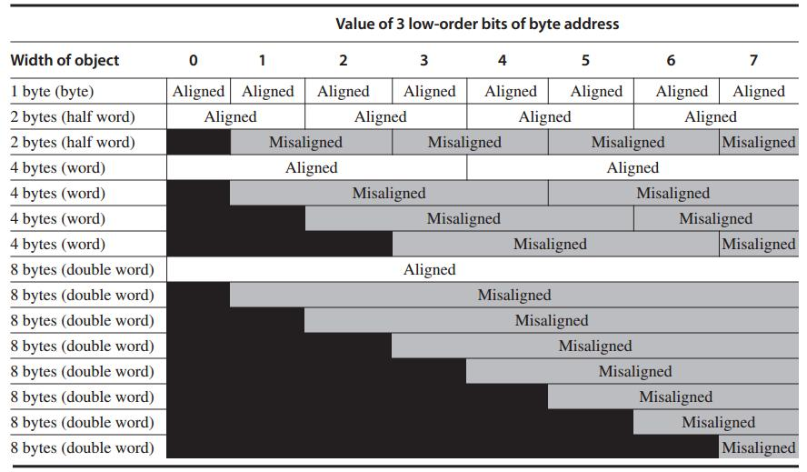
Each misaligned object requires two memory accesses
Notes:
This picture clearly demonstrates that address alignment helps limit memory access times.
When well aligned, requires only one memory access to read one object;
If address is not well aligned, each misaligned object requires two memory accesses to fetch.
(operand width related)

Slide 60
ISA: Types and Sizes of OPerands
Type | Size in bits
ASCII character | 8
Unicode character Half word | 16
Integer word | 32
Double word Long integer | 64
IEEE 754 floating point – single precision | 32
IEEE 754 floating point – double precision | 64
Floating point – extended double precision | 80
Notes:
(operand width/size related)
Here’s an overview of types and sizes of instruction operands.

Slide 61
ISA: Addressing Modes
Specify the location of operands
registers, constants, or the address of a memory object:
RISC-V:
Register, Immediate, Displacement
constant
Add R4, #3
register + constant
Add R4, 100(R1)
Notes:
(how to find/access the desired operand)
An instruction has three addressing modes for it to specify the address of a memory object as one of its operands.
For RISC-V, the operand could be a register, an immediate, or a displacement.
For register, the operand is just the name/alias of the register.
for immediate, it’s a constant that can be directly used as an operand.
For displacement, it specifies a register in addition to a constant, then we need to add the constant to the value stored in the register, the result is the corresponding memory address.

Slide 62
ISA: Addressing Modes
Specify the location of operands
registers, constants, or the address of a memory object:
80x86: 3 more variations of disp
Register, Immediate, Displacement
no register (absolute)
Add R1, (1001)
Notes:
https://www.geeksforgeeks.org/addressing-modes-8086-microprocessor/
The 80x86 supports those three modes, plus three variations of displacement:
No registers (absolute)
Two registers (based indexed with displacement)
Two registers where one register is multiplied by the size of the operand in bytes (based with scaled index and displacement)

Slide 63
ISA: Addressing Modes
Specify the location of operands
registers, constants, or the address of a memory object:
80x86: 3 more variations of disp
Register, Immediate, Displacement
two registers (based indexed with disp)
Add R3, 1000(R1+R2)
Notes:
The 80x86 supports those three modes, plus three variations of displacement:
No registers (absolute)
Two registers (based indexed with displacement): In this type of addressing mode the effective address is the sum of index register, base register and displacement.
Two registers where one register is multiplied by the size of the operand in bytes (based with scaled index and displacement)

Slide 64
ISA: Addressing Modes
Specify the location of operands
registers, constants, or the address of a memory object:
80x86: 3 more variations of disp
Register, Immediate, Displacement
two registers (based with scaled & disp)
Add R1, 100(R2)[R3]
Mem[100+Regs[R2]+Regs[R3]*d]
given d-byte operand
Notes:
The 80x86 supports those three modes, plus three variations of displacement:
No registers (absolute)
Two registers (based indexed with displacement)
Two registers where one register is multiplied by the size of the operand in bytes (based with scaled index and displacement)

Slide 65
ISA: Addressing Modes
Specify the location of operands
registers, constants, or the address of a memory object:
80x86: still some more w/o disp
Register, Immediate, Displacement
register indirect
Add R4, (R1)
Mem[Regs[R1]]
Notes:
The 80x86 has some more addressing modes like the previous modes without the displacement field:
Register indirect: memory locations stored in a register; used when accessing using a pointer or a computed address;
Indexed:
Based with scaled index:

Slide 66
ISA: Addressing Modes
Specify the location of operands
registers, constants, or the address of a memory object:
80x86: still some more w/o disp
Register, Immediate, Displacement
indexed
Add R3, (R1+R2)
Mem[Regs[R1]+Regs[R2]]
Notes:
The 80x86 has some more addressing modes like the previous modes without the displacement field:
Register indirect: memory locations stored in a register; used when accessing using a pointer or a computed address;
Indexed: sometimes useful in array addressing R1=base of array and R2=index amount;
Based with scaled index:

Slide 67
ISA: Addressing Modes
Specify the location of operands
registers, constants, or the address of a memory object:
ARMv8:
Register, Immediate, Displacement
PC-relative addressing
beq $0, $5, Label1
PC + offset*
*left-shifted by 2 and sign-extended
Notes:
ARMv8 has the three addressing modes (register, immediate, displacement) plus:
PC-relative addressing: The PC-relative addressing mode can be used to load a register with a value stored in program memory a short distance away from the current instruction. It can be seen as a special case of the "base plus offset" addressing mode, one that selects the program counter (PC) as the "base register". / PC-relative addressing is used for conditional branches. The address is the sum of the program counter and a constant in the instruction (beq: Branch if EQual)
The sum of two registers:
The sum of two registers where one register is multiplied by the size of the operand in bytes:
Autoincrement addressing:
Autodecrement addressing:

Slide 68
ISA: Addressing Modes
Specify the location of operands
registers, constants, or the address of a memory object:
ARMv8:
Register, Immediate, Displacement
sum of two registers
ADD, R3, (R1+R2)
Notes:
ARMv8 has the three addressing modes (register, immediate, displacement) plus:
PC-relative addressing: The PC-relative addressing mode can be used to load a register with a value stored in program memory a short distance away from the current instruction. It can be seen as a special case of the "base plus offset" addressing mode, one that selects the program counter (PC) as the "base register". / PC-relative addressing is used for conditional branches. The address is the sum of the program counter and a constant in the instruction
The sum of two registers: as it is; as in example
The sum of two registers where one register is multiplied by the size of the operand in bytes:
Autoincrement addressing:
Autodecrement addressing:

Slide 69
ISA: Addressing Modes
Specify the location of operands
registers, constants, or the address of a memory object:
ARMv8:
Register, Immediate, Displacement
scaled index addressing
Add R1, (R2)[R3]
Mem[Regs[R2]+Regs[R3]*d]
given d-byte operand
Notes:
ARMv8 has the three addressing modes (register, immediate, displacement) plus:
PC-relative addressing: The PC-relative addressing mode can be used to load a register with a value stored in program memory a short distance away from the current instruction. It can be seen as a special case of the "base plus offset" addressing mode, one that selects the program counter (PC) as the "base register". / PC-relative addressing is used for conditional branches. The address is the sum of the program counter and a constant in the instruction
The sum of two registers: as in example
The sum of two registers where one register is multiplied by the size of the operand in bytes: as in example
Autoincrement addressing:
Autodecrement addressing:

Slide 70
ISA: Addressing Modes
Specify the location of operands
registers, constants, or the address of a memory object:
ARMv8:
Register, Immediate, Displacement
autoincrement addressing
Add R1, (R2)+
Mem[Regs[R2]]
Regs[R2]← Regs[R2]+d
Notes:
ARMv8 has the three addressing modes (register, immediate, displacement) plus:
PC-relative addressing: The PC-relative addressing mode can be used to load a register with a value stored in program memory a short distance away from the current instruction. It can be seen as a special case of the "base plus offset" addressing mode, one that selects the program counter (PC) as the "base register". / PC-relative addressing is used for conditional branches. The address is the sum of the program counter and a constant in the instruction
The sum of two registers: as in example
The sum of two registers where one register is multiplied by the size of the operand in bytes: as in example
Autoincrement addressing: useful for stepping through arrays within a loop. R2 points to the start of an array; each reference increments R2 by size of an element, d;
Autodecrement addressing:

Slide 71
ISA: Addressing Modes
Specify the location of operands
registers, constants, or the address of a memory object:
ARMv8:
Register, Immediate, Displacement
autodecrement addressing
Add R1, -(R2)
Regs[R2]← Regs[R2]-d
Mem[Regs[R2]]
Notes:
ARMv8 has the three addressing modes (register, immediate, displacement) plus:
PC-relative addressing: The PC-relative addressing mode can be used to load a register with a value stored in program memory a short distance away from the current instruction. It can be seen as a special case of the "base plus offset" addressing mode, one that selects the program counter (PC) as the "base register". / PC-relative addressing is used for conditional branches. The address is the sum of the program counter and a constant in the instruction
The sum of two registers: as in example
The sum of two registers where one register is multiplied by the size of the operand in bytes: as in example
Autoincrement addressing: useful for stepping through arrays within a loop. R2 points to the start of an array; each reference increments R2 by size of an element, d;
Autodecrement addressing: same use as autoincrement. Autodecrement/-increment can also act as push/pop to implement a stack.

Slide 72
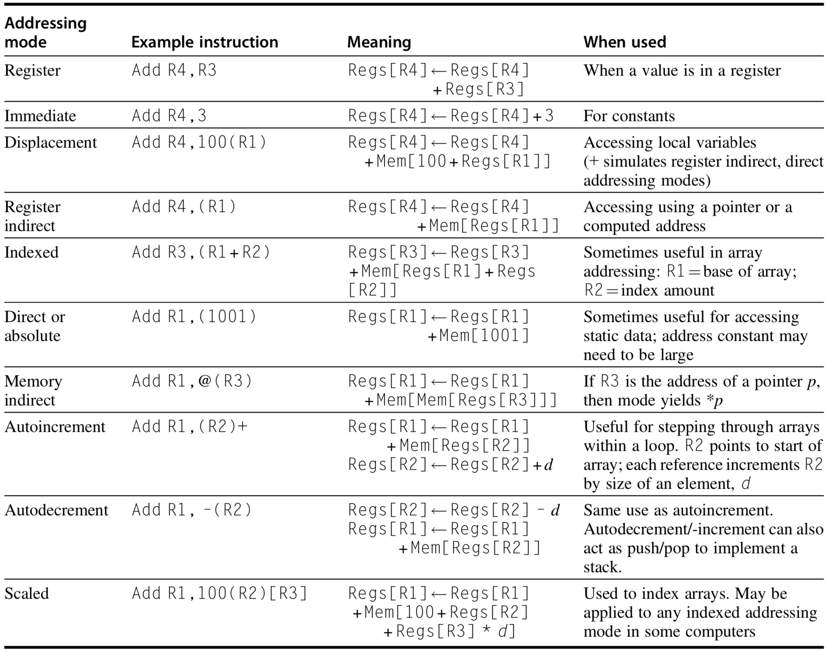
Addressing Modes
Notes:
This table summarizes different addressing modes and their meanings.
For example,

Slide 73
ISA: Operations
Four general categories
data transfer
arithmetic logical
control
floating point
Notes:
With an instruction, we could achieve one of the following four categories of operations:
They are data transfer operation, arithmetic logical operation, control operation, floating point operation;

Slide 74
MIPS64 Operations
Data transfer
Notes:
The tables list example instructions of each operation type.

Slide 75
MIPS64 Operations
Arithmetic Logical

Slide 76
MIPS64 Operations
Control

Slide 77
MIPS64 Operations
Floating point

Slide 78
RISC-V Operations
Data Transfer

Slide 79
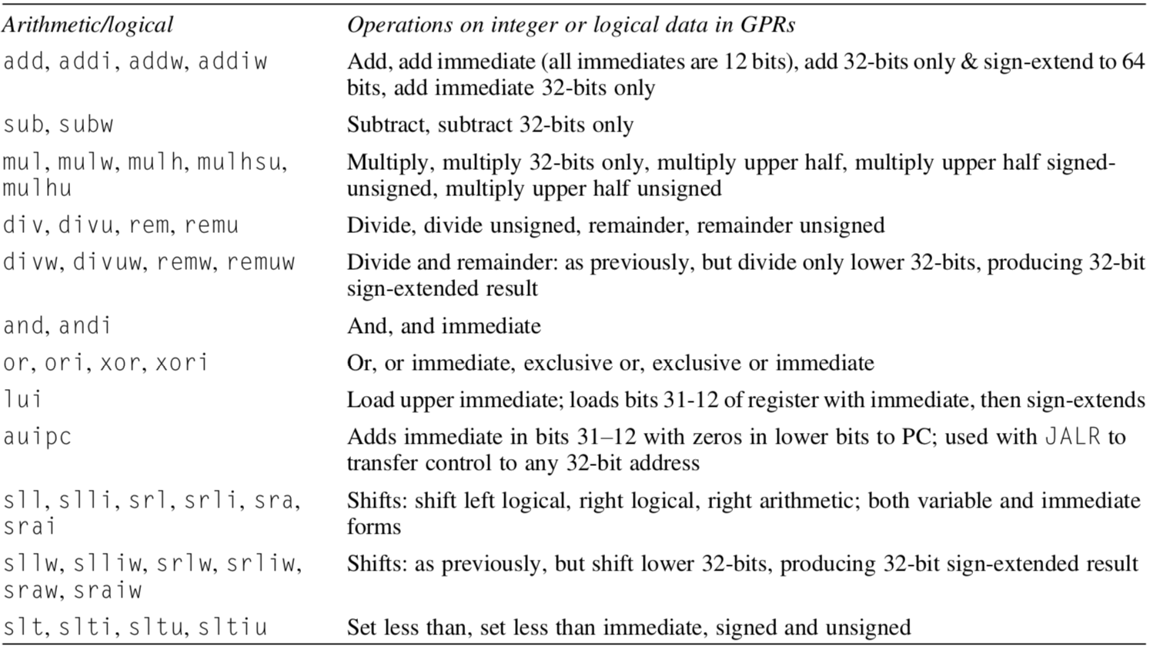
RISC-V Operations
Arithmetic Logical

Slide 80
RISC-V Operations
Control

Slide 81
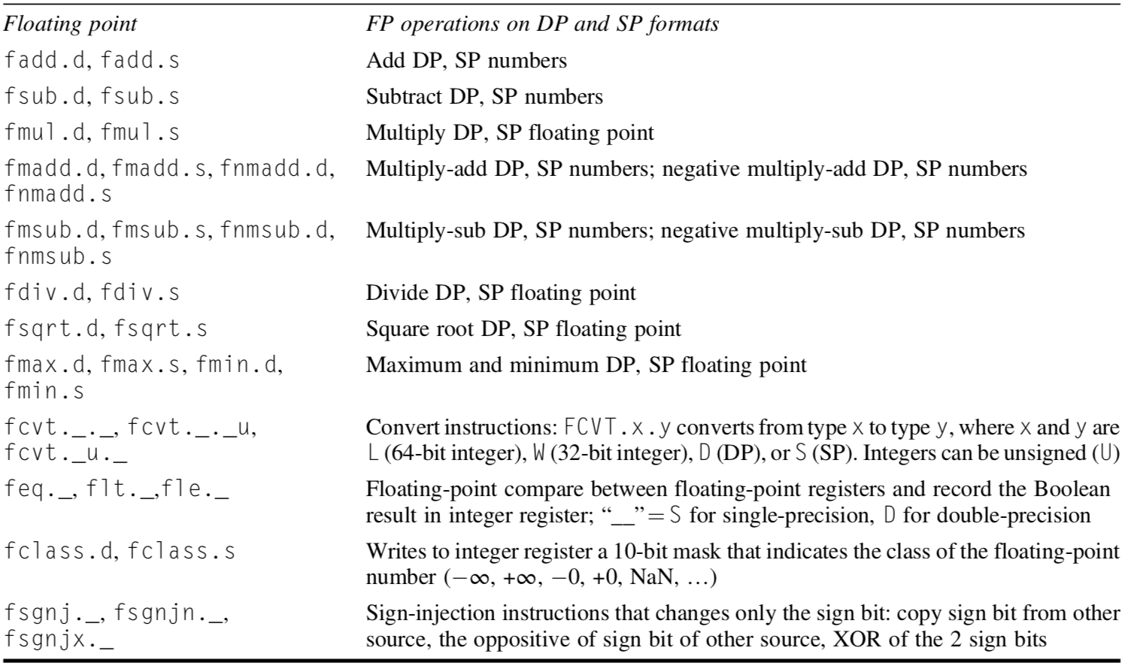
RISC-V Operations
Floating point

Slide 82
ISA: Control Flow Instructions
Types:
conditional branches
unconditional jumps
procedure calls
returns
PC-relative addressing:
Branch address = add an address field to PC (program counter)
Notes:
Control instructions also have various types;
All of them use PC-relative addressing, where the branch address is specified by an address field that is added to the PC.
We’ll discuss more about them in later lecture sessions.

Slide 83
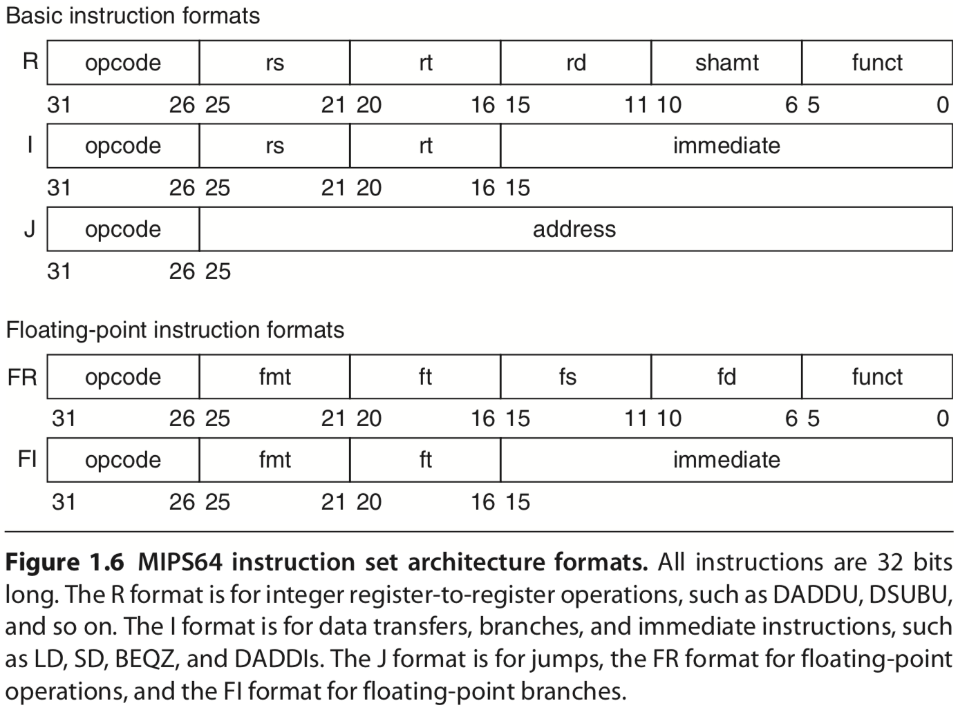
ISA: Encoding an ISA
Fixed length: ARM, MIPS, RV – 32 bits
Variable length: 80x86 – 1~18 bytes
http://en.wikipedia.org/wiki/MIPS_architecture
https://inst.eecs.berkeley.edu/~cs61c/resources/MIPS_help.html
Start with a 6-bit opcode. R-type: register three registers, a shift amount field, and a function field; I-type: immediate two registers, a 16-bit immediate value; J-type: jump a 26-bit jump target.
Notes:
As we mentioned, instructions should be encoded in a format understandable to computer hardware, right?
Here are various possible types of instruction formats.
Again, we’ll detail them in later chapters.
R type: rs, rt – the first and second operand; rd – destination register
MIPS reference sheet: https://inst.eecs.berkeley.edu/~cs61c/resources/MIPS_help.html

Slide 84
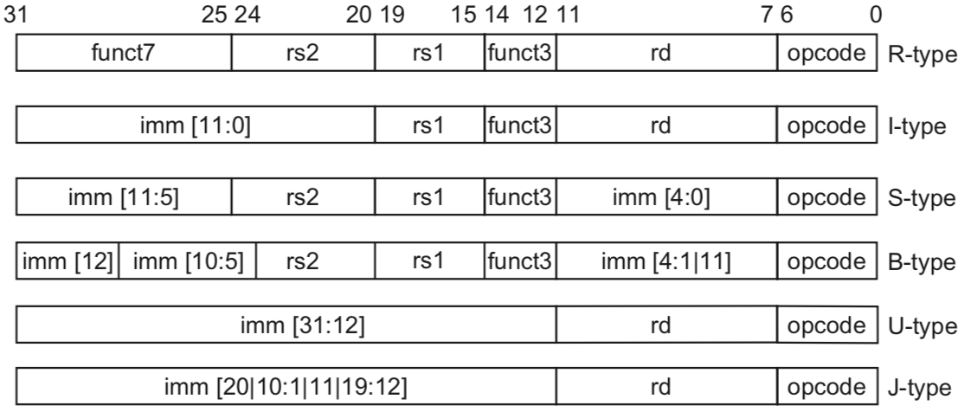
ISA: Encoding an ISA
RISC-V
Notes:
RISC-V ISA encoding;
Might discuss them in later chapters;

Slide 85
How to implement an ISA?
Notes:
How to implement an ISA, for it to work

Slide 86
How to implement a computer?
Notes:
In other words, how to implement a computer that supports certain ISA for users to work on?

Slide 87
How to implement a computer?
Organization
+
Hardware
/microarchitecture
high-level aspects
of computer design:
memory system,
memory interconnect,
design of internal processor or CPU;
computer specifics:
logic design,
packaging tech;
Notes:
The implementation of a computer has two components: organization and hardware.
The term organization includes the high-level aspects of a computer’s design, such as the memory system, the memory interconnect, and the design of the internal processor or CPU (central processing unit—where arithmetic, logic, branching, and data transfer are implemented).
Hardware refers to the specifics of a computer, including the detailed logic design and the packaging technology of the computer.

Slide 88
Again, what’s computer architecture?
Notes:
Now, putting all together, let’s again more comprehensively define computer architecture.

Slide 89
Computer Architecture
ISA
Organization
Hardware
actual programmer
visible instruction set;
boundary between sw
and hw;
high-level aspects
of computer design:
memory system,
memory interconnect,
design of internal processor or CPU;
computer specifics:
logic design,
packaging tech;
Notes:
it actually covers all three aspects of computer design: instruction set architecture, organization (or microarchitecture), and hardware;
The implementation of a computer has two components: organization and hard- ware. The term organization includes the high-level aspects of a computer’s design, such as the memory system, the memory interconnect, and the design of the internal processor or CPU (central processing unit—where arithmetic, logic, branching, and data transfer are implemented). The term microarchitecture is also used instead of organization. For example, two processors with the same instruction set architectures but different organizations are the AMD Opteron and the Intel Core i7. Both processors implement the 80x86 instruction set, but they have very different pipeline and cache organizations.
Hardware refers to the specifics of a computer, including the detailed logic design and the packaging technology of the computer. Often a line of computers contains computers with identical instruction set architectures and very similar organizations, but they differ in the detailed hardware implementation. For exam- ple, the Intel Core i7 (see Chapter 3) and the Intel Xeon E7 (see Chapter 5) are nearly identical but offer different clock rates and different memory systems, mak- ing the Xeon E7 more effective for server computers.

Slide 90
Computer Architecture
ISA
Organization
Hardware
actual programmer
visible instruction set;
boundary between sw
and hw;
high-level aspects
of computer design:
memory system,
memory interconnect,
design of internal processor or CPU;
computer specifics:
logic design,
packaging tech;
Computer architects must design the organization and hardware
to meet functional requirements
as well as price, power, performance, and availability goals.
Notes:
In summary, computer architects must design the organization and hardware to meet functional requirements as well as price, power, performance, and availability goals.

Slide 91
Review
5 classes of computers
Parallelism
Instruction set architecture
Computer architecture

Slide 92
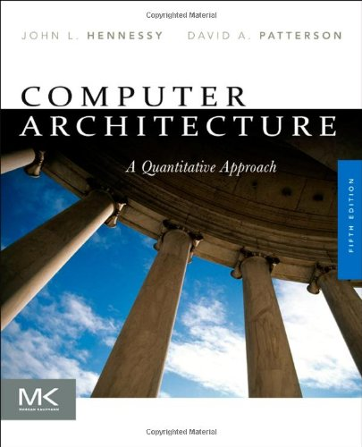
Chapter 1.1-1.3
Notes:
The contents discussed can be found in the first part of Chapter 1.

Slide 93
Lab 1
Demo Due: October 12, 2020
Report Due: October 19, 2020
Reference

Slide 94
Assignment 1
link
25 min presentation per group
October 19, 08:00 – 12:15
Room 502, CGB Building East Wing
Bonus
tbd…for the best presentation group
Suggestions? Make it fun!

Slide 95
?

Slide 96
Thank You
be on the road
Notes:
Run your own race.

Slide 97
#What’s More
If you can dream it, you can accomplish it.
What's Your Dream by LinkedIn
If not now, when?
The 3 Secrets of Highly Successful Graduates by Reid Hoffman
Notes:
With our mutual efforts, let’s engage more in this class so that we can really ENJOY the teaching and learning process.

