Slide 1
WOW
Notes:
wowowow

Slide 2
Finally, Computer Architecture!
01
Notes:
Thank you for studying

Slide 3
Computer Architecture!
Notes:
this very challenging hardware course with me.
First, let me ask you some questions. Which hardware courses did you complete?
What did you learn in those courses?
How about software courses?
It’s great to know that you have already built a solid background of computer science.
But as you may or may not have noticed, when you learn the software courses, you follow a top-down approach

Slide 4
Computer Architecture!
program
Notes:
At first, you started with various programming languages, like C and Java.
Through those courses, you might have developed some fancy programs/applications and become very much amazed by how awesome our computers can be.
And hopefully, you might’ve also accumulated a strong interest in computer science.
After a while, you might have become more curious about how exactly your programs are handled by computers.
For example, when you open a file or print a string on the screen, you simply call a function like OpenFile and Print, but you don’t need to worry about how to implement the called functions.
Instead, standard libraries of the programming language in use do that for you.
Meanwhile, you may have noticed that when you install certain sdk on your computer, you usually need to choose a specific version that suits your operating system.

Slide 5
Computer Architecture!
program
operating system
Notes:
So, operating system is a special program that manages other programs.
First, an operating system provides necessary support for function implementation in Libraries. For example, the OpenFile function implementation in Library may further call a function defined in the code of the operating system.
More importantly, an operating system manages computer hardware and software resources and provides common services for computer programs. For example, many tasks may be running on our computers. It is the operating system that decides which task accesses which resources at which time instance.

Slide 6
Computer Architecture!
program
operating system
digital logic
Notes:
When you study the hardware courses, you followed a bottom up approach.
You probably started with Digital Logic, which models computer computation at a very low level.
For example, how information is modeled by signals in a binary fashion, how a single transistor represents a bit, how a gate achieves simple operations over a combination of transistors;

Slide 7
Computer Architecture!
program
operating system
organization
digital logic
Notes:
apparently, it is challenging to always break up a complex computation into sub-computations supported by digital logic
That’s why you get to know more computation units in the course of computer organization.
In computer organization, you also learned other components like CPU, memory, and I/O, that are indispensible for computation.
So far, there is still one major question left unresolved: how exactly do these computer components cooperate to complete a computation?

Slide 8
Computer Architecture!
program
operating system
organization
digital logic
Notes:
In the course of Computer Architecture, you will reveal this missing piece.
As shown in the slide, computer architecture is a layer between software and hardware
It is an Architect/microarchitect’s view of how to design a computer that meets system design goals;
Design choices critically affect both the software programmer and the hardware designer.
So far, any questions?

Slide 9
Computer Architecture!
?
Notes:
What will be covered in this course?
To answer this question, let’s walk through how our computers solve a problem and see where computer architecture fits in.

Slide 10
problem
electrons
Notes:
Given a problem, eventually it’ll be the electrons that drive our computers to generate the result.
But before that, we need to go through a sequence of steps.

Slide 11
problem
algorithm
electrons
Notes:
First, we need to design a method to solve the problem. In computer science, such methods are called algorithms.

Slide 12
problem
algorithm
program
electrons
Notes:
Then based on your algorithm design, you use certain programming language to implement it into an executable program.

Slide 13
problem
algorithm
program
runtime system
(VM, OS, MM)
electrons
Notes:
As we mentioned, program execution depends on operating system.
Different operating systems may have different ways to handle your programs.

Slide 14
problem
algorithm
program
runtime system
(VM, OS, MM)
ISA (architecture)
electrons
Notes:
Also, in hardware courses, we know that program written in high-level programming languages cannot be understood by computer hardware.
Instead, programs need to be compiled into instructions.
what instructions will your program be turned into depends on which Instruction Set Architecture (ISA) is used by your computer.
An ISA defines how to encode an instruction and how underlying hardware decodes it.

Slide 15
problem
algorithm
program
runtime system
(VM, OS, MM)
ISA (architecture)
microarchitecture
electrons
Notes:
How an instruction is processed depends on specific architecture design. For example, at any time instance, only one instruction can be executed or different instructions can be co-executed with each instruction using a different component.

Slide 16
problem
algorithm
program
runtime system
(VM, OS, MM)
ISA (architecture)
microarchitecture
logic
electrons
Notes:
Each component in use is composed by a number of digital logics,

Slide 17
problem
algorithm
program
runtime system
(VM, OS, MM)
ISA (architecture)
microarchitecture
logic
circuits
electrons
Notes:
which are constructed by integrated circuits driven by electrons.
Among all of these layers, which will be covered in computer architecture?
(levels of transformation create abstractions
Abstraction: a higher level only needs to know about the interface to the lower level,
not how the lower level is implemented)

Slide 18
Computer Architecture!
problem
algorithm
program
runtime system
(VM, OS, MM)
ISA (architecture)
microarchitecture
logic
logic
circuits
electrons
Notes:
These are the parts that will be covered in this course
Two major new parts beyond previous courses are ISA and microarchitecture;
Meanwhile, it highly couples with some background knowledge in previous courses,
Such as organization, os, and assembly language

Slide 19
Computer Architecture!
challenging
runtime system
(VM, OS, MM)
ISA (architecture)
microarchitecture
logic
logic
Notes:
So obviously it’s gonna be very challenging.

Slide 20
Computer Architecture!
challenging
for me as well…
runtime system
(VM, OS, MM)
ISA (architecture)
microarchitecture
logic
logic
Notes:
And it’s still challenging for me as well, even after years of teaching this course,

Slide 21
for me?
Notes:
Well

Slide 22
Instructor
Kai Bu 卜凯
Associate Professor, College of CS, ZJU
Ph.D. from Hong Kong PolyU, 2013
Visiting Professor, SFU, 2018
Research Interests:
network, security, computer architecture
research interns wanted
http://list.zju.edu.cn/kaibu
Notes:
I’m Kai Bu, an Associate Professor in CS college.
I graduated from Hong Kong PolyU in 2013.
I teach computer architecture.
I conduct research in networking and security.
I usually host excellent undergraduate students in my group.
If you happen to be interested in my research, I’ll be more than happy to work with you.
Before that, you might like to know more about me via my webpage.

Slide 23
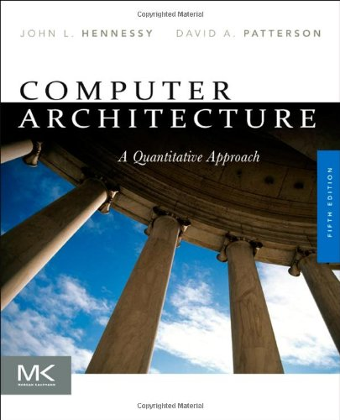
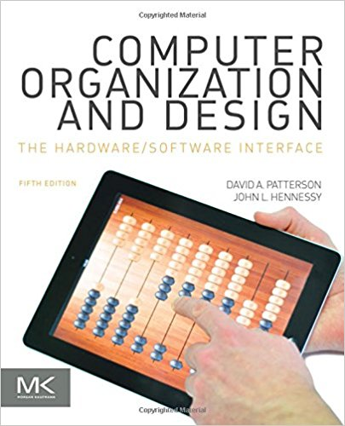
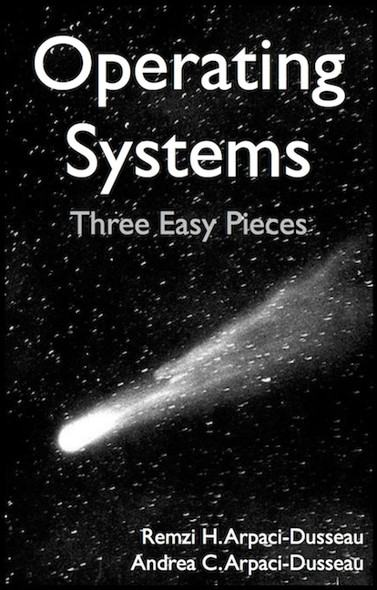
How I Prepared (and am still preparing)
read textbooks
Notes:
Now back to the course, since it’s very challenging;
You might wonder that, as the instructor, how I prepared for teaching this course.
First, I read related textbooks, for many times.

Slide 24
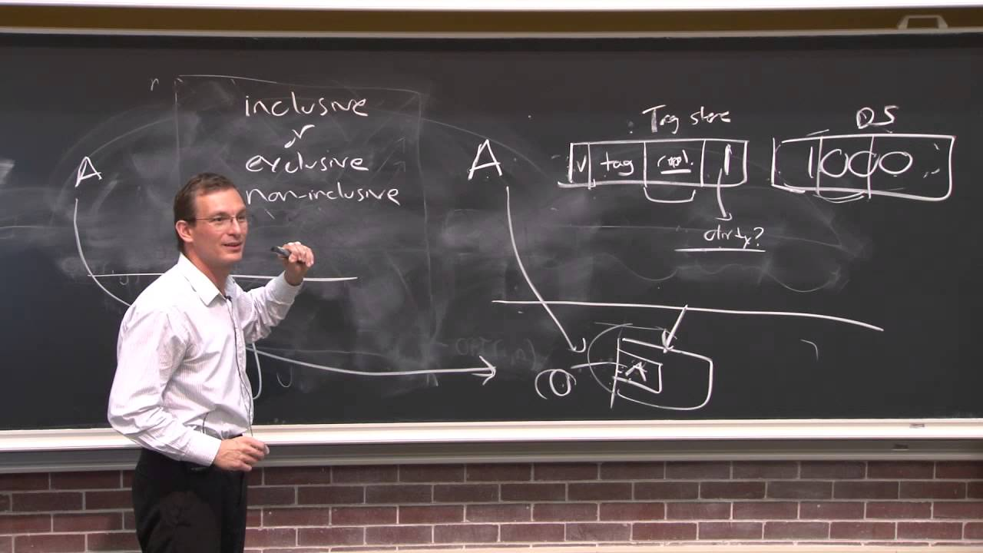
How I Prepared (and am still preparing)
watch video lectures
Notes:
Watch online video lectures

Slide 25
How I Prepared (and am still preparing)
practice English
Notes:
Practice English

Slide 26
and
even
read
this
book
Notes:
And, I also read a book that is literally called Teaching What You Don’t Know

Slide 27
What’s to deliver?
Notes:
So, after these much preparation, what can I offer to students in my class?

Slide 28
How a multi-core system works?
Notes:
After this course, you are expected to understand how a multi-core system works;
Intro: cpu chip in this fig, multiple cores, each core has local/private L1 and L2 caches, all cores share L3 cache, connect to memory via memory controller

Slide 29
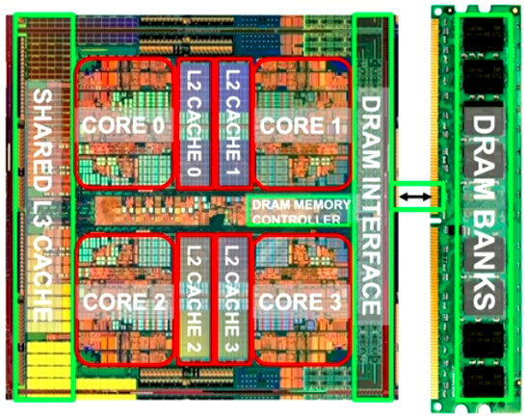
How a multi-core system works?
Notes:
Cpu and memory – computer architecture

Slide 30
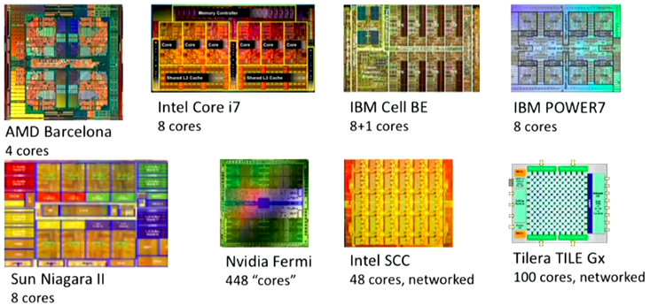
How a multi-core system works?
Notes:
More examples of multi-core CPUs

Slide 31
know not only how but also why
Notes:
You’ll start paying attention to not only how something works but also why it works in that way.
You may also start wondering why it doesn’t work in some other ways.

Slide 32
understand the principles
Notes:
Through such comparison, you can better understand the working principles of things.

Slide 33
explore the tradeoffs of
different designs and ideas
Notes:
You’ll more and more get used to seeing things from different perspectives.
At most cases, a solution cannot be the best at every perspective.
You need to decide which perspective you care the most, and in order to get more benefits from this perspective, you might need to sacrifice some in terms of other perspectives.
Example, membership query using hash: space and accuracy;

Slide 34
thought-provoking!
Notes:
Probably it’ll be the most thought-provoking course you’ve even taken so far.

Slide 35
Textbook
Computer Architecture:
A Quantitative Approach
5th edition
John L. Hennessy
David A. Patterson
Notes:
The textbook we use is Computer Architecture: A quantitative approach 5th edition by Professor Hennessy and Professor Patterson.

Slide 36
Textbook
Computer Architecture:
A Quantitative Approach
6th edition
John L. Hennessy
David A. Patterson
Notes:
The content will also cover some updates from the sixth edition

Slide 37
Online Companion
5th Edition
https://booksite.elsevier.com/9780123838728/index.php
6th Edition
https://www.elsevier.com/books-and-journals/book-companion/9780128119051
Notes:
A varriety of resources are available online including reference appendices and links to related materials on the Web, etc.

Slide 38
Why This Book?
Quantitative approach:
Performance driven
Know not only how but also why
As in this book
Operating Systems: Three Easy Pieces
Notes:
So why this book?
It presents computer architecture design in a quantitative approach, which adopts a performance-driven perspective. In other words, whenever it delivers a design technique, it clearly motivates how this technique makes our computers faster or better in terms of other measurement methodology.
So it tells us not only how computer architecture works but also why it works in the way it is designed.
You are also strongly encouraged to read the book Operating Systems: Three Easy Pieces as well, as os is a prerequisite for computer architecture.

Slide 39
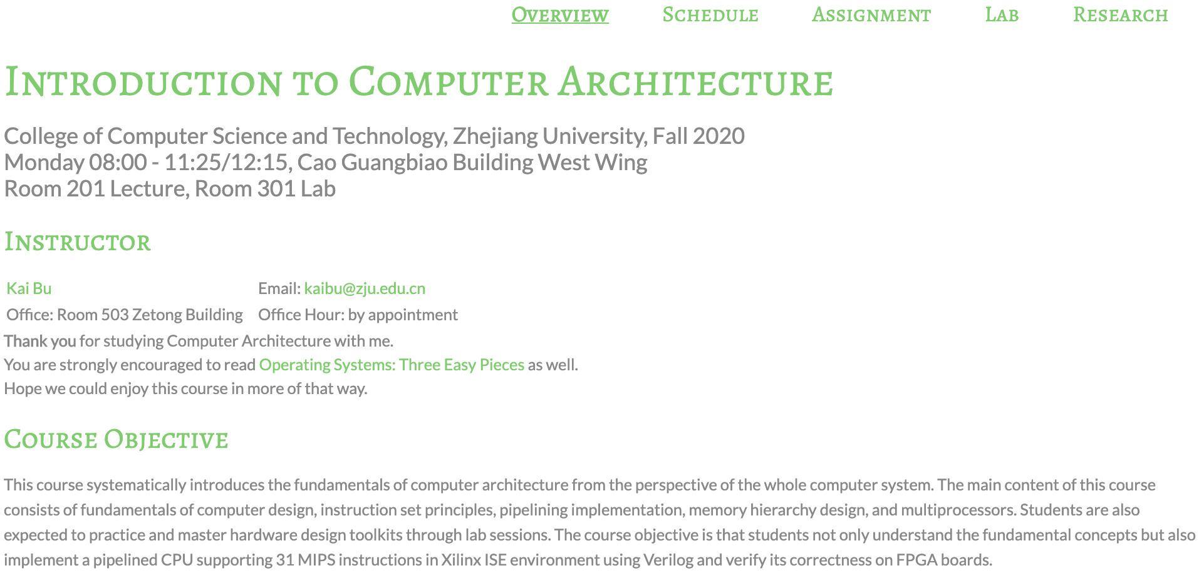
Course Website
http://list.zju.edu.cn/kaibu/comparch2020/
Notes:
all announcements and materials like slides and assignments will be posted on this website.

Slide 40
Syllabus
Reference syllabus by Prof. Jiang
http://list.zju.edu.cn/kaibu/comparch2015/Syllabus_2013spring.pdf
Notes:
Here’re the links for reference syllabus

Slide 41
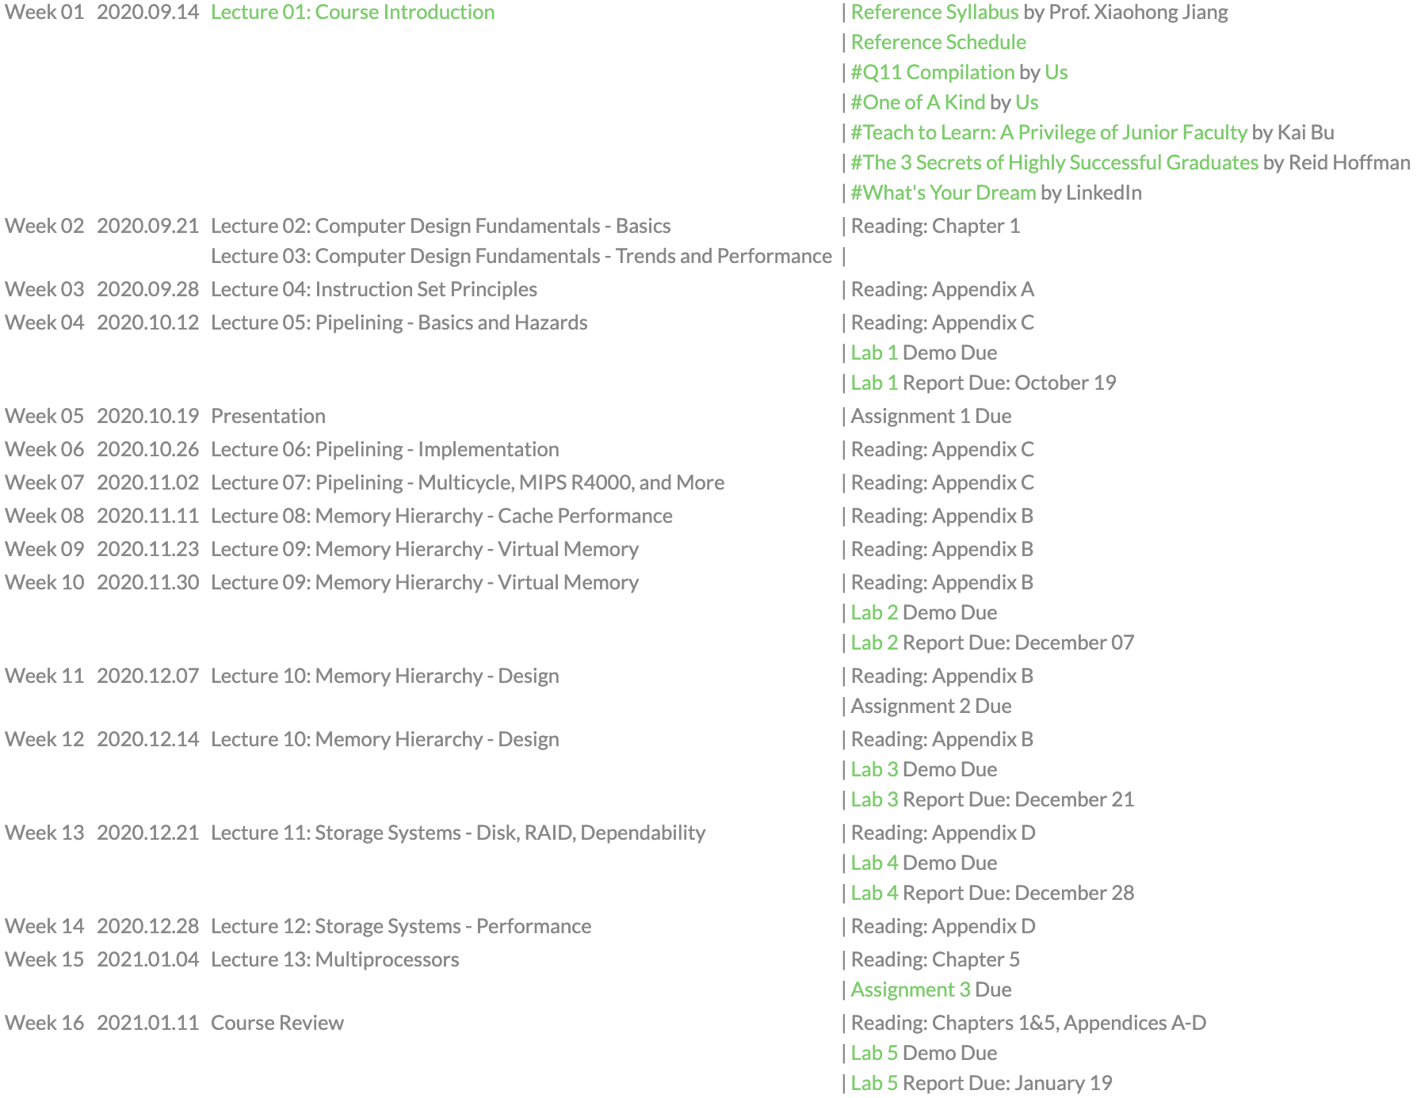
Schedule
Reference schedule
http://list.zju.edu.cn/kaibu/comparch2019/schedule.html
Notes:
and schedule

Slide 42
Teaching Components
Lecture
Lab OR Research
Assignment & Quiz & Exam
Notes:
The course contains three major teaching components; they are lectures, labs OR research practice, and tests including assignments, quizzes, and exams;

Slide 43
Teaching Components
Lecture
Lab OR Research
Assignment & Quiz & Exam
Notes:
Let’s start from walking through the key topics to be covered in lectures.

Slide 44
Left off in Organization
single cycle
instruction execution
Notes:
This is where you left off in Computer Organization, computer hardware processes an instruction in a single clock cycle.
By single clock cycle, it means that within each clock cycle, only one instruction is being processed.
Limitation? (long clock cycles, other instructions have to wait even though some components are idle)

Slide 45
Left off in Organization
s i n g l e c y c l e
instruction execution
Notes:
This is where you left off in Computer Organization, computer hardware processes an instruction in a single clock cycle.
By single clock cycle, it means that within each clock cycle, only one instruction is being processed.
Limitation? (long clock cycles, other instructions have to wait even though some components are idle)
A long single cycle
Long single clock
Set clock frequency
To fit the longest instruction
The overall extra waiting time
For shorter instructions

Slide 46
Left off in Organization
m u l t i p l e c y c l e s
instruction execution
Notes:
This is where you left off in Computer Organization, computer hardware processes an instruction in a single clock cycle.
By single clock cycle, it means that within each clock cycle, only one instruction is being processed.
Limitation? (long clock cycles, other instructions have to wait even though some components are idle)
Or a shorter cycle, yet taking multiple cycles for an instruction (instructions with varying cycles to complete)
Discussions:
Pros and cons of multi-cycle
State diagram, diff instruction goes through different number of states
So, averagely, save extra waiting time?

Slide 47
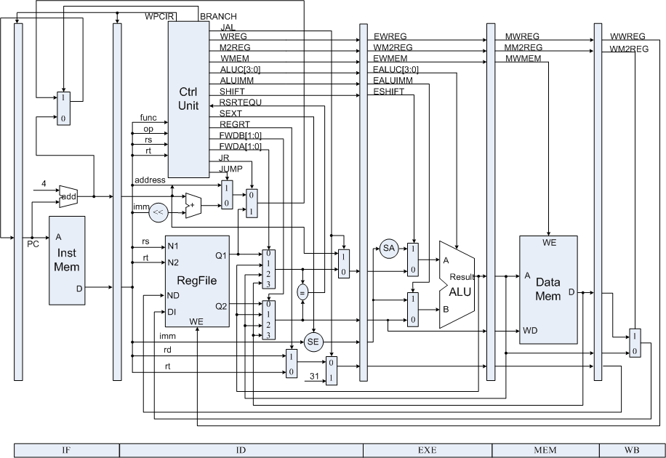
Now in Architecture
Pipelining
Divide instruction execution into stages

Slide 48
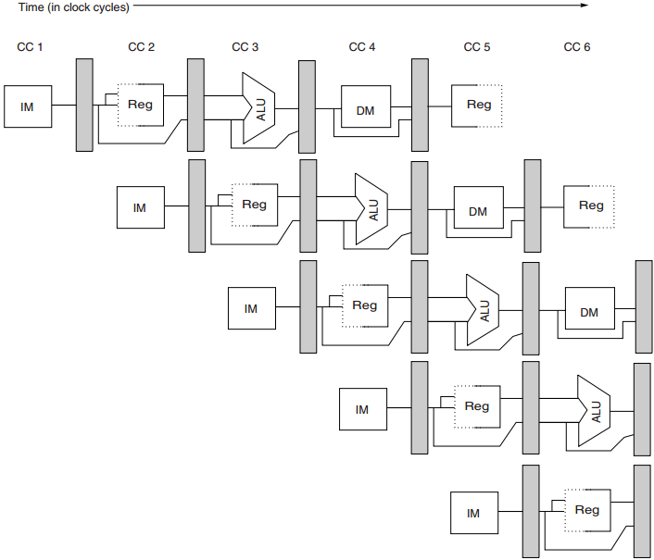
Pipelining
start executing one instruction
before completing the previous one

Slide 49
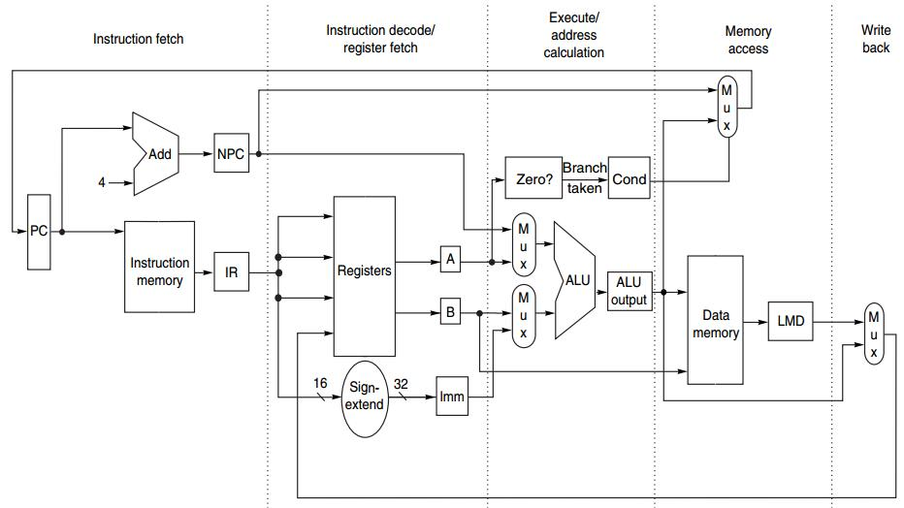
MIPS Instruction
at most 5 clock cycles per instruction
IF ID EX MEM WB

Slide 50
MIPS Instruction
IF ID EX MEM WB
IR ← Mem[PC];
NPC ← PC + 4;

Slide 51
MIPS Instruction
IF ID EX MEM WB
A ← Regs[rs];
B ← Regs[rt];
Imm ← sign-extended
immediate field
of IR (lower 16 bits)

Slide 52
MIPS Instruction
IF ID EX MEM WB
ALUOutput ← A + Imm;
ALUOutput ← A func B;
ALUOutput ← A op Imm;
ALUOutput ← NPC + (Imm<<2);
Cond ← (A == 0);

Slide 53
MIPS Instruction
IF ID EX MEM WB
LMD ← Mem[ALUOutput]; Mem[ALUOutput] ← B;
if (cond) PC ← ALUOutput;

Slide 54
MIPS Instruction
IF ID EX MEM WB
Regs[rd] ← ALUOutput;
Regs[rt] ← ALUOutput;
Regs[rt] ← LMD;

Slide 55
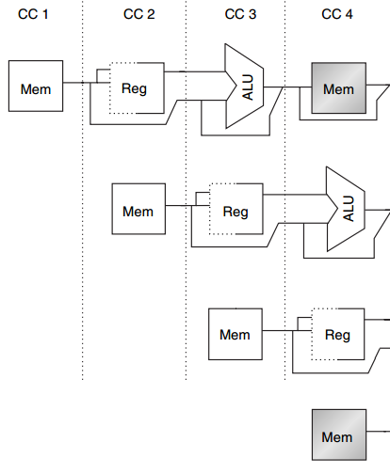
Structural Hazard
MEM
Example
1 mem port
mem conflict
data access
vs
instr fetch
Load
Instr i+1
Instr i+2
IF
Instr i+3
Notes:
Here’s an example of structural hazard due to memory conflict.
Assume the processor has only memory port.
A structural hazard will arise in clock cycle 4 when the load instruction reads data from memory and instruction i plus 3 fetches instruction from memory.

Slide 56
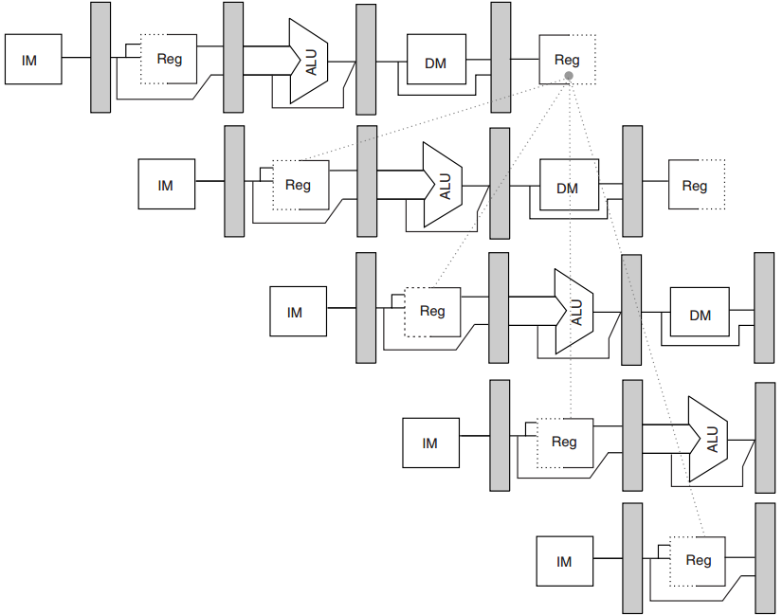
Data Hazard
R1
DADD
R1, R2, R3
DSUB
R4, R1, R5
AND
R6, R1, R7
No hazard
1st half cycle: w
2nd half cycle: r
OR
R8, R1, R9
XOR
R10, R1, R11
Notes:
In this example, the subtract and AND instructions need R1 before the add instruction prepares it. So R1 causes a data hazard that prevents normal pipelining of the subtract and AND instructions.
Note that the OR instruction has no hazard because the add instruction prepares R1 in the first half of the clock cycle while the OR instruction needs R1 till the second half.

Slide 57
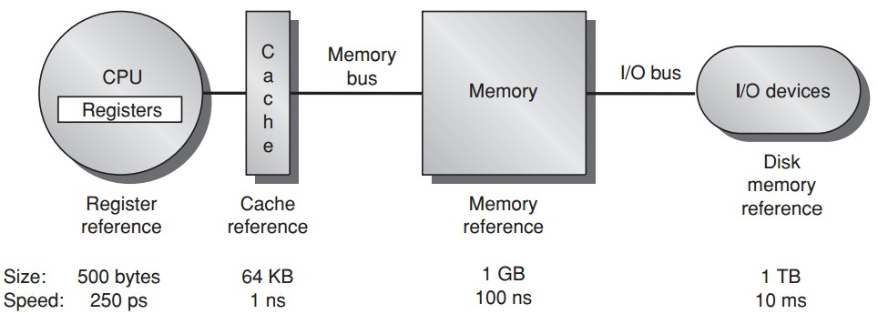
Memory Hierarchy

Slide 58
Cache Performance
Memory stall cycles
the number of cycles during processor is stalled waiting for a mem access
Miss rate
number of misses over number of accesses
Miss penalty
the cost per miss (number of extra clock cycles to wait)

Slide 59
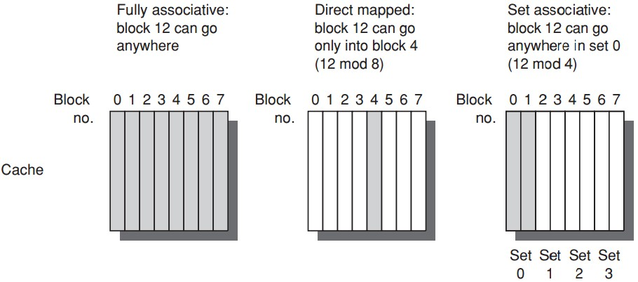
Block Placement

Slide 60
Multilevel Cache
Two-level cache
Add another level of cache between the original cache and memory
L1: small enough to match the clock cycle time of the fast processor;
L2: large enough to capture many accesses that would go to main memory, lessening miss penalty

Slide 61
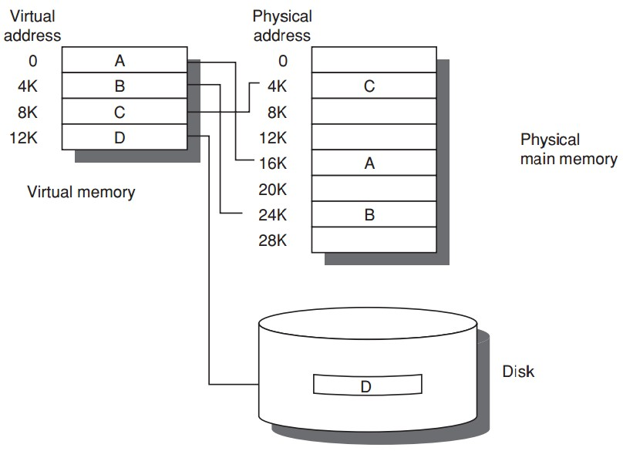
Virtual Memory
Program uses
discontiguous memory locations
Use secondary/non-memory storage

Slide 62
Virtual Memory
Program thinks
contiguous memory locations
larger physical memory

Slide 63
Prior Virtual Memory
Main/Physical Memory
Contiguous allocation
Direct memory access
Direct memory access
allocated
Process A
Process B
allocated
Notes:
If we directly map process address space to physical memory address, we need to follow contiguous allocation like this.
Then each process can use direct memory access using physical memory address.

Slide 64
Prior Virtual Memory
Main/Physical Memory
efficiency?
used
Process A
Process B
used
Notes:
One possible limitation of such direct memory access is low memory efficiency.
As we can see, at certain time instants, a process uses way less memory than it is allocated for.

Slide 65
Prior Virtual Memory
Main/Physical Memory
protection?
used
Process A
Process B
used
Notes:
Another limitation is lack of memory protection to prevent a process from accessing memory allocated for other processes.

Slide 66
Prior Virtual Memory
Main/Physical Memory
Easier/flexible memory management
Virtual memory
used
used
Process A
Process B
used
used
Notes:
To address the above limitations, virtual memory introduces an indirect mapping from the memory address processes use to the physical memory address where data actually locates.

Slide 67
Prior Virtual Memory
Main/Physical Memory
Share a smaller amount of physical memory among many processes
Virtual memory
used
used
Process A
Process B
used
used
Notes:
Each process still thinks that the same amount of memory space is allocated for it;
But in practical, not all data need to be pre-loaded into memory and processed data could be evicted from memory.
This way, a smaller physical memory can support more processes.

Slide 68
Prior Virtual Memory
Main/Physical Memory
Physical memory allocations
need not be contiguous
Virtual memory
used
used
used
Process A
used
Process B
used
used
used
used
Notes:
Besides, memory allocations no longer need to be contiguous,
Virtual address can point to any physical address.

Slide 69
Prior Virtual Memory
Main/Physical Memory
memory protection;
process isolation
Virtual memory
used
used
used
Process A
used
Process B
used
used
used
used
Notes:
As now processes access memory through virtual address instead of physical address,
with well designed address mapping,
we can make sure that a process cannot access memory allocated for other processes.

Slide 70
Prior Virtual Memory
Main/Physical Memory
Introduces another level of
secondary storage
Virtual memory
used
used
used
Process A
used
Process B
used
used
used
used
Notes:
To support larger virtual memory space, data blocks corresponding to virtual addresses can also be temporarily stored in secondary storage like disk and swapped to memory when needed.

Slide 71
Virtual Memory
Paged virtual memory
page: fixed-size block
Segmented virtual memory
segment: variable-size block

Slide 72
Virtual Memory
Paged virtual memory
page address: page # + offset
Segmented virtual memory
segment address: seg # + offset

Slide 73
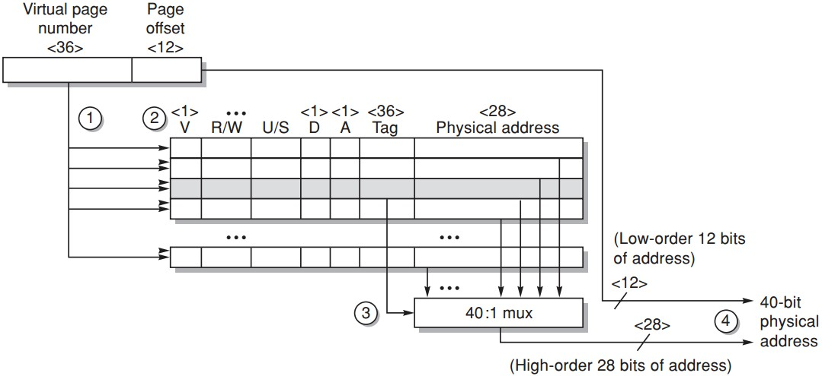
TLB Example
Opteron data TLB
Steps 1&2: send the virtual address to all tags
Step 2: check the type of mem access against protection info in TLB
https://www.youtube.com/watch?v=95QpHJX55bM
Notes:
Here’s an example of how TLB works for address translation.
First, the virtual page number is sent to compare with all tags;

Slide 74
TLB Example
Opteron data TLB
Steps 3: the matching tag sends phy addr through multiplexor
Notes:
The matching tag returns its physical page number through multiplexor;

Slide 75
TLB Example
Opteron data TLB
Steps 4: concatenate page offset to phy page frame to form final phy addr
Notes:
Then the physical page number is combined with page offset to form the physical address.

Slide 76
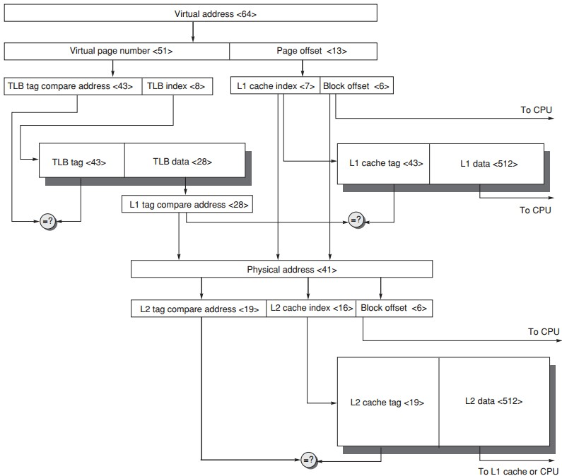
Virtual Memory + Caches

Slide 77
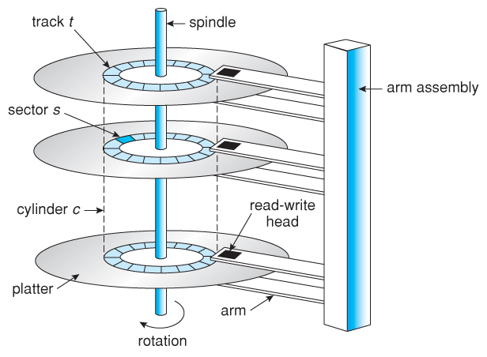
Disk
http://www.cs.uic.edu/~jbell/CourseNotes/OperatingSystems/images/Chapter10/10_01_DiskMechanism.jpg

Slide 78
Disk Arrays
Disk arrays with redundant disks to tolerate faults
If a single disk fails, the lost information is reconstructed from redundant information
Striping: simply spreading data over multiple disks
RAID: redundant array of inexpensive/independent disks

Slide 79
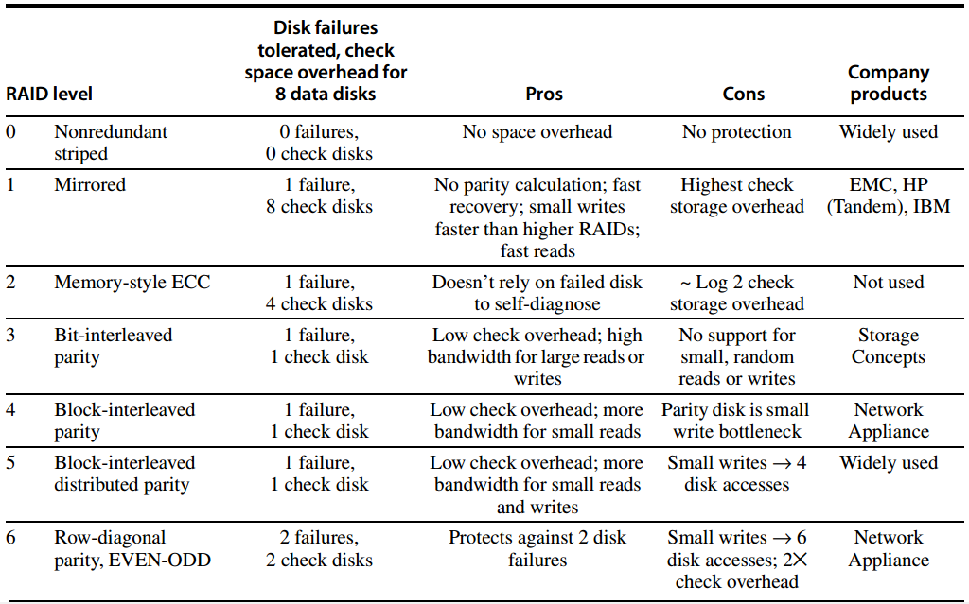
RAID

Slide 80
RAID 0
JBOD: just a bunch of disks
No redundancy
No failure tolerated
Measuring stick for other RAID levels: cost, performance, and dependability

Slide 81
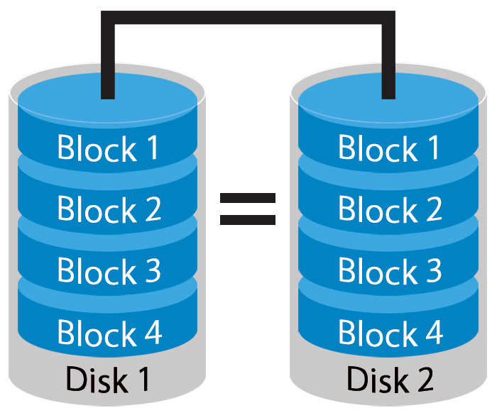
RAID 1
Mirroring or Shadowing
Two copies for every piece of data
one logical write = two physical writes
100% capacity/space
overhead
http://www.petemarovichimages.com/wp-content/uploads/2013/11/RAID1.jpg

Slide 82
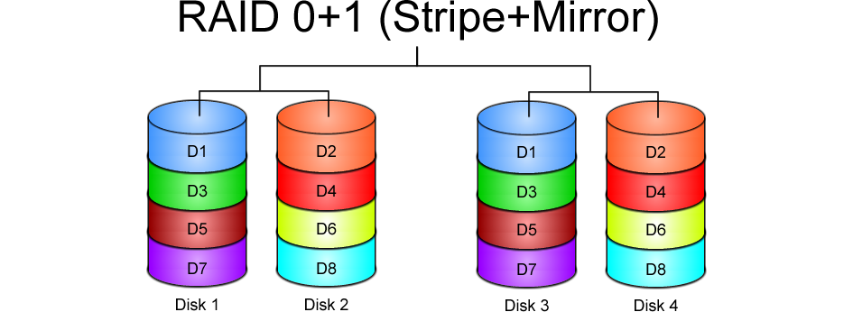
https://www.icc-usa.com/content/raid-calculator/raid-0-1.png

Slide 83
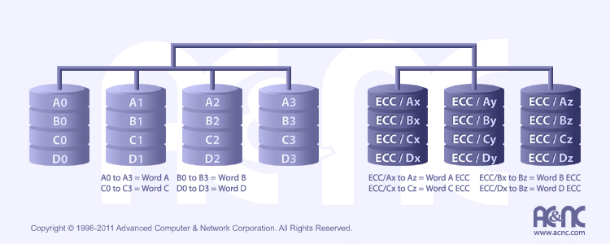
RAID 2
http://www.acnc.com/raidedu/2
Each bit of data word is written to a data disk drive
Each data word has its (Hamming Code) ECC word recorded on the ECC disks
On read, the ECC code verifies correct data or corrects single disks errors
Notes:
Each bit of data word is written to a data disk drive, accompanied with the word’s ECC spread over the ECC disks

Slide 84
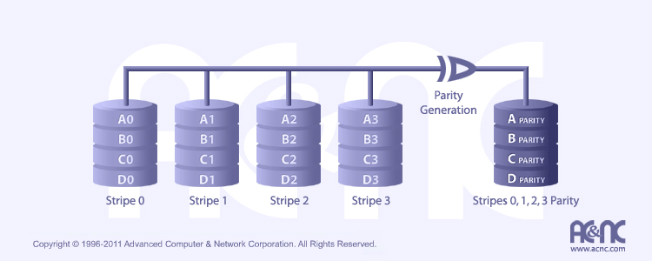
RAID 3
http://www.acnc.com/raidedu/3
Data striped over all data disks
Parity of a stripe to parity disk
Require at least 3 disks to implement

Slide 85
RAID 3
Even Parity
parity bit makes
the # of 1 even
p = sum(data1) mod 2
P
1
0
1
0
0
0
1
1
1
1
0
0
1
1
0
1
1
0
1
0
0
0
1
1
1
1
0
0
1
1
0
1

Slide 86
RAID 3
Even Parity
parity bit makes
the # of 1 even
p = sum(data1) mod 2
Recovery
if a disk fails,
“subtract” good data
from good blocks;
what remains is missing data;
P
1
0
1
0
0
0
1
1
1
0
1
0
0
0
1
1
1
1
0
0
1
1
0
1

Slide 87
RAID 3
“subtract”
1 – 1 = 0
1 – 0 = 1
0 – 1 = 1
0 – 0 = 0
Even Parity
parity bit makes
the # of 1 even
p = sum(data1) mod 2
Recovery
if a disk fails,
“subtract” good data
from p of good blocks;
what remains is missing data;
P
1
0
1
0
0
0
1
1
1
1
0
0
1
1
0
1
1
0
1
0
0
0
1
1
1
1
0
0
1
1
0
1

Slide 88
RAID 4
http://www.acnc.com/raidedu/4
Favor small accesses
Allows each disk to perform independent reads, using sectors’ own error checking
independent read - not read across multiple disks

Slide 89
RAID 3 & RAID 4
bottleneck:
single parity disk
access:
parallel vs independent

Slide 90
RAID 3 & RAID 4
? bottleneck:
single parity disk
access:
parallel vs independent

Slide 91
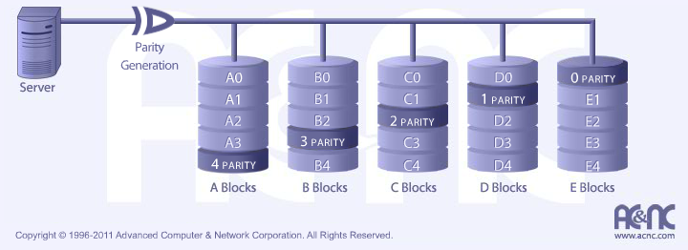
RAID 5
http://www.acnc.com/raidedu/5
Distributes the parity info across all disks in the array
Removes the bottleneck of a single parity disk as RAID 3 and RAID 4

Slide 92
RAID 6: Row-diagonal Parity
RAID-DP
Recover from two failures
xor⊕
row: 00⊕11⊕22⊕33=r4
diagonal: 01⊕11⊕31⊕r1=d1

Slide 93
RAID 6: Row-diagonal Parity
RAID-DP
Recover from two failures
xor⊕
row: 00⊕11⊕22⊕33=r4
diagonal: 01⊕11⊕31⊕r1=d1

Slide 94
Double-Failure Recovery

Slide 95
Double-Failure Recovery

Slide 96
Double-Failure Recovery

Slide 97
Double-Failure Recovery

Slide 98
Double-Failure Recovery

Slide 99
Double-Failure Recovery

Slide 100
Double-Failure Recovery

Slide 101
Double-Failure Recovery

Slide 102
Double-Failure Recovery

Slide 103
Double-Failure Recovery

Slide 104
Double-Failure Recovery

Slide 105
Double-Failure Recovery

Slide 106
Double-Failure Recovery

Slide 107
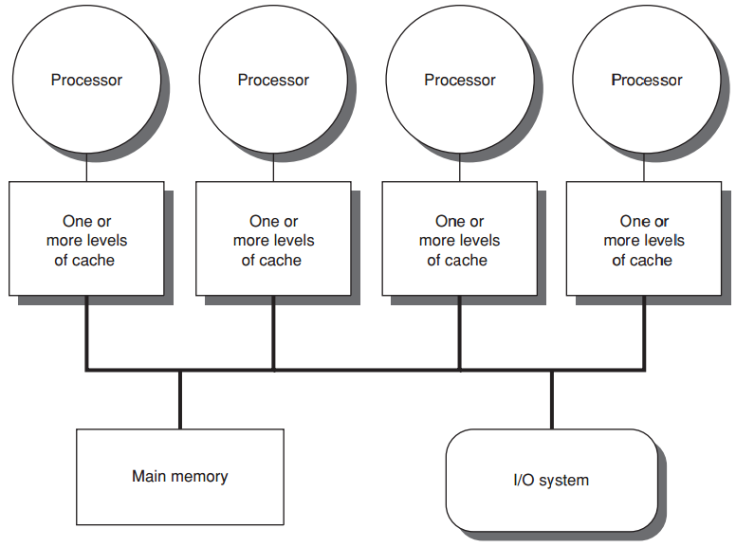
centralized shared-memory
eight or fewer cores

Slide 108
centralized shared-memory
Share a single centralized memory
All processors have equal access to

Slide 109
centralized shared-memory
All processors have uniform latency from memory
Uniform memory access (UMA) multiprocessors

Slide 110
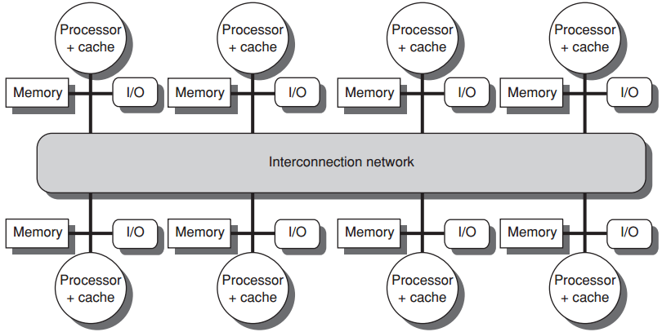
distributed shared memory
more processors
physically distributed memory

Slide 111
distributed shared memory
more processors
physically distributed memory
Distributing mem among the nodes
increases bandwidth & reduces local-mem latency

Slide 112
distributed shared memory
more processors
physically distributed memory
NUMA: nonuniform memory access
access time depends on data word loc in mem

Slide 113
distributed shared memory
more processors
physically distributed memory
Disadvantages:
more complex inter-processor communication
more complex software to handle distributed mem

Slide 114
Cache Coherence Problem
A memory system is Coherent if any read of a data item returns the most recently written value of that data item
Two critical aspects
coherence: defines what values can be returned by a read
consistency: determines when a written value will be returned by a read

Slide 115
Cache Coherence Problem
w/o precautions
write-through cache
Notes:
The problem concerning whether the value of shared data is identical in different caches is called cache coherence problem.

Slide 116
Textbook Navigation
Fundamentals: Chapter 1
Instruction: Appendix C & Chapter 3
Memory: Appendix B & Chapter 2
Storage: Appdenix D
Multiprocessor: Chapter 5

Slide 117
Teaching Components
Lecture
Lab OR Research
Assignment & Quiz & Exam
Notes:
Together with lecture sessions, we also have tight lab schedules to practice what we learn.

Slide 118
Labs
6 lab sessions (tentative)
Pipeline implementation
Cache implementation
Demo: individual OR group of up two
Report: individual
Notes:
In particular, through 6 lab assignments, we aim to implement pipeline and cache.

Slide 119
Labs
Lab 1
warmup Spartan 3E and ISE environment;
update verilog code of multi-cycle CPU to 3E board;
add one new branch instruction;
reference code:
Spartan 3E Display: http://list.zju.edu.cn/kaibu/comparch/lab1-Spartan3E-Display.rar
Spartan Simulation: http://list.zju.edu.cn/kaibu/comparch/spartansimulation.txt
Notes:
In the first lab session, we start from warming up the experiment environment.
Here are some reference codes you might use to get experiment tools work.

Slide 120
Labs
Lab 2
implement 5-stage pipelined CPU with 15 MIPS instructions;
Lab 3
implement stall technique against pipelining hazards;
Lab 4
implement forwarding paths toward faster CPU;
Lab 5
implement a pipelined CPU with 31 MIPS instructions;
use predict-not-taken policy to solve control hazard;
Lab 6
cache (tbd)
Notes:
Labs 2 through 5 are dedicated to pipeline implementation while lab 6 is for cache implementation.

Slide 121
Labs
Call for lab assistants
help tutor & check the demo during lab sessions;
get bonus credit;
Notes:
For students who are familiar with lab experiments, you are strongly encouraged to join me as lab assistants.
As a lab assistant, you are expected to help tutor students and check demos.
Then, of course, you can get bonus credit as reward.

Slide 122
Teaching Components
Lecture
Lab OR Research
Assignment & Quiz & Exam
Notes:
Together with lecture sessions, we also have tight lab schedules to practice what we learn.

Slide 123
Research Practice
http://list.zju.edu.cn/kaibu/comparch2020/
research.html
WOW THE CLASS!

Slide 124
Why do you care?
Notes:
So why do u care about the research part?

Slide 125
waive lab demos&reports
Notes:
So why do u care about the research part?

Slide 126
spice up
graduate application

Slide 127
Special Thanks
Weixin Liang (Stanford)
Ke Li (Columbia)
Jinhong Li (CUHK)
Min Huang (CMU)
Qinhan Tan (Princeton)
Zhihua Zeng (VMware)
Yiming Wei (ZJU)
Chenlu Miao, Jingsen Zhu, Miao Zhang, Xingjian Zhang, Yuan Tian, Tianqi Song

Slide 128
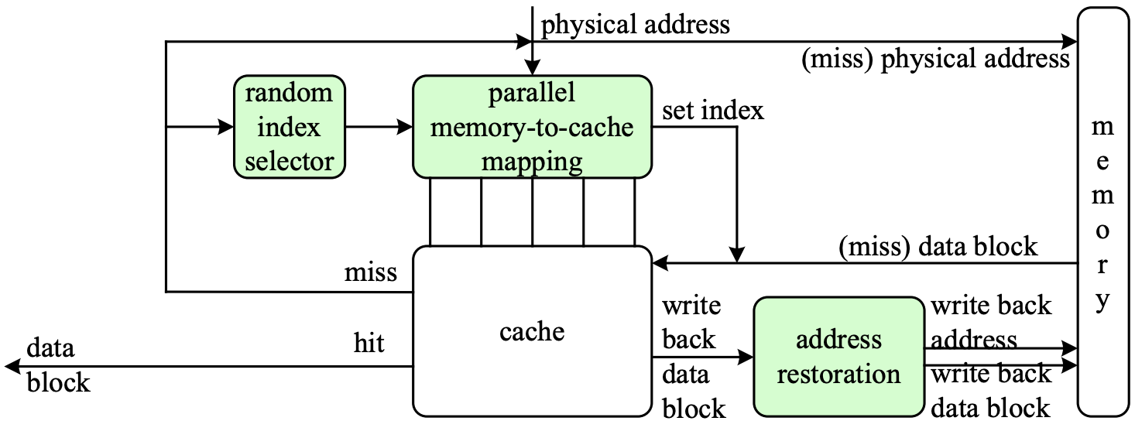
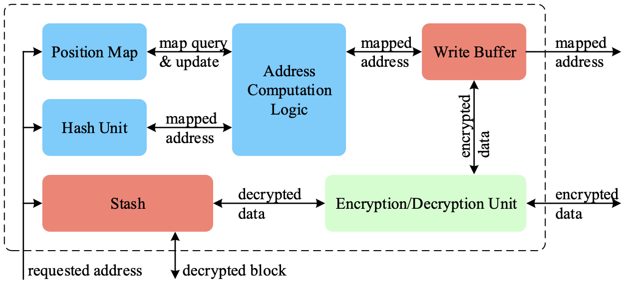
WOW
PhantomCache
NDSS 2020
MemCloak
ACSAC 2018

Slide 129
More than that?
Notes:
But what’s more than that is if you really go deep into the research practice,

Slide 130
learn to learn things differently
Notes:
You’ll learn to learn things differently

Slide 131
know not only how but also why
Notes:
You’ll start paying attention to not only how something works but also why it works in that way.
You may also start wondering why it doesn’t work in some other ways.

Slide 132
read this book and you’ll see Operating Systems: Three Easy Pieces http://pages.cs.wisc.edu/~remzi/OSTEP/
Notes:
Again, I’m recommending the book Operating Systems: three easy pieces;
It’ll help to shape your research mind as well as build background knowledge for computer architecture.

Slide 133
Grade?
Notes:
Finally, the part you care the most,

Slide 134
Grading (tentative)
4% | Class Participation & Performance
16% | Assignment
8% | Quiz
32% | Lab OR Research
40% | Final Exam closed-book + memo 10:30 – 12:30, January 23, 2021
Notes:
Grading policy
Now we’ve talked about several components this course requires, here’s how they contribute to the final grade.

Slide 135
How will I teach?
Notes:
Then, how will I teach?

Slide 136
What Students Expect from Teachers
Fun
Humor
Expertise
Easy exam
High grades
…
Notes:
For most of us, an ideal teacher should be fun and humorous, meanwhile, he or she should be an expert for what is taught.
More important, exams should be easy and grades should be high.

Slide 137
I wish I knew someone like this, too…
Notes:
Well, you can’t always get what u want, right?

Slide 138
Teaching Plan
Keep it Simple
Focus on the core concepts
Try to help you more easily understand
Notes:
So here’s how I teach.
As a junior faculty member, I’m gradually getting familiar with what I teach as well.
For every teaching component, I’ll try to keep it simple and focus on the core concepts. The ultimate goal of my teaching is to help you more easily understand what the textbook delivers.

Slide 139
Learn, Teach, Inspire
Teach to Learn: A Privilege of Junior Faculty
“If we can contribute, in whatever way,
to a students' pursuit of a better self,
even if it is not about the course per se,
we still succeed as educators.”

Slide 140
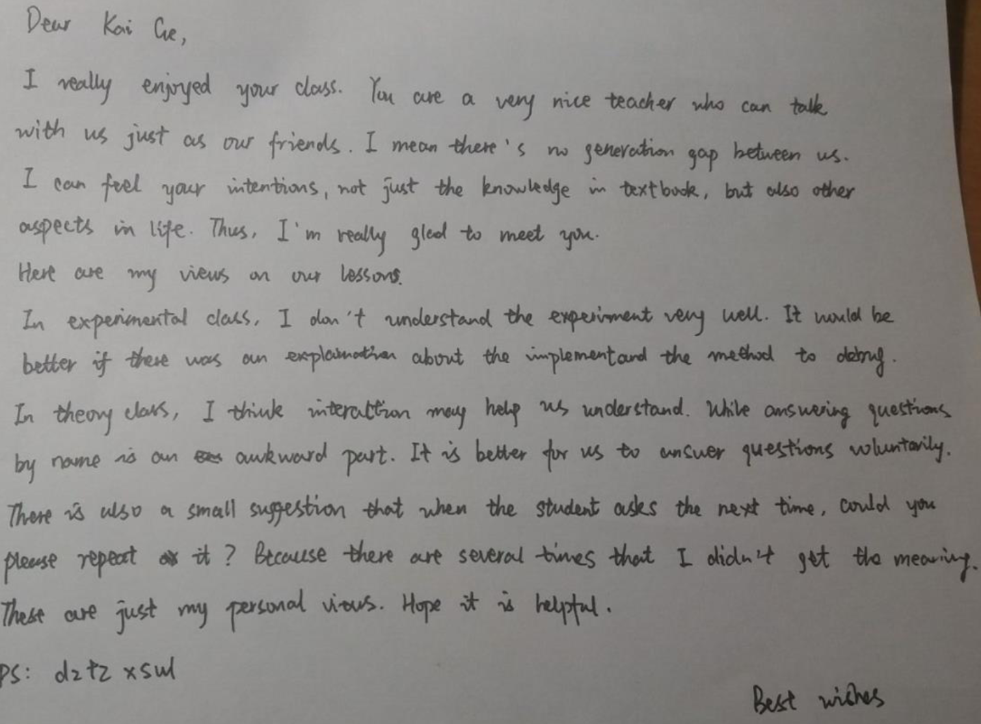
Rumor Has It?
find out more from
Q11.pdf

Slide 141
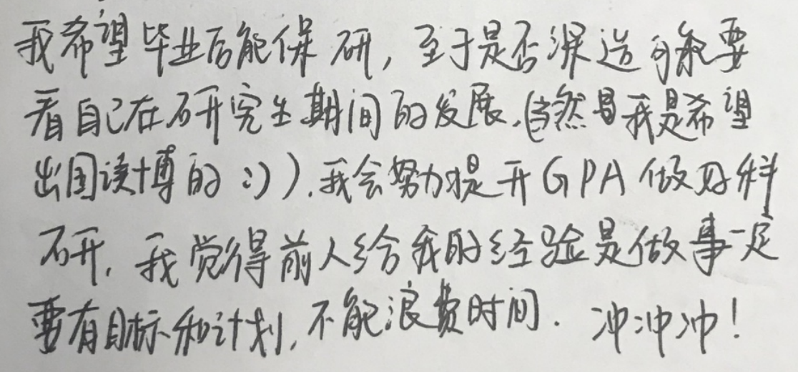
To Every One of A Kind
find out more from
Q11.pdf 2nd edition
Notes:
Also value students’ goals and strengths, and try to help them if possible…;

Slide 142
#What’s More to Share
helpful/inspiring resources
#The 3 Secrets of Highly Successful Graduates by Reid Hoffman
Notes:
I’ll also share with you some helpful or inspiring videos and articles.

Slide 143
How will you contribute?
Notes:
Besides my efforts, your contributions are also indispensible.

Slide 144
Thanks In Advance
Study group
Lab assistants
Research interns
…
AT LEAST
submit assignments & lab reports
show up to final exam
Notes:
For example, you can start study groups for peer discussion, you can help me as lab assistants or research interns.
At least, please submit assignments in time and show up to final exam.
Believe it or not, some students just don’t.

Slide 145
Enjoy, xixi
Notes:
Hope you’ll enjoy

Slide 146
Deal?

Slide 147
QQ Group: 533944879
Notes:
One more request, join this qq group for ease of off-line discussion.

Slide 148
WOW, Member #400

Slide 149
?
Notes:
So far, we have introduced course logistics and contents.
Any questions?

Slide 150
Who’s Who
Notes:
Roster;
Now it’s time for the class to get the first impression of each of you.
Briefly introduce yourself if you like when I call ur name; you could use either English or Chinese.

Slide 151
Ready?
Notes:
Great to know u all,
Now, Ready for an adventure to computer architecture?

Slide 152
#The 3 Secrets of Highly Successful Graduates
Notes:
Cause if not now, when?

