Slide 1




unXpec: Breaking Undo-based Safe Speculation
Mengming Li, Chenlu Miao, Yilong Yang, Kai Bu
Zhejiang University
HPCA’22, April 2-6, 2022
Notes:
Hi, my name is Mengming Li. I’m a second year master student at Zhejiang University. “Hi, I’m Chenlu Miao, I’m a first year master student at Zhejiang University”. Today, we will present unXpec: Breaking Undo-based Safe Speculation. This work is done with my collaborator Chenlu Miao, Yilong Yang and my advisor Kai Bu at Zhejiang university. Basically, we come up with a new variant of speculative execution attack targeting the undo-based safe speculation. Our attack shows that the undo-based defenses may be exploited to form the new timing channel and leak secrets. Simply repairing it would make system incur significant overhead. Let’s start.

Slide 2
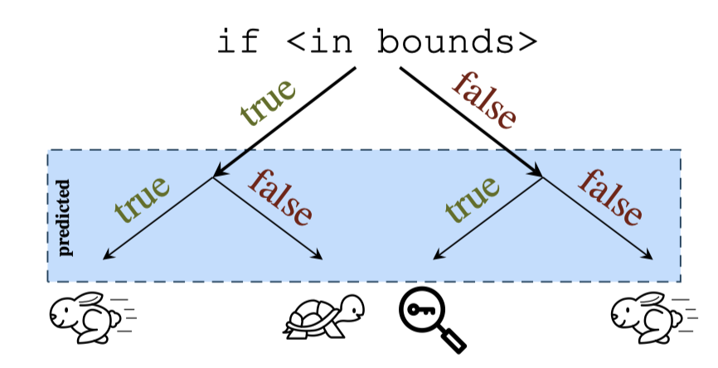
Background: Speculative Execution Attacks
Speculative execution is widely used to speed up execution
The mis-speculated instructions are exploited to leak secrets
Paul Kocher et al.,
Spectre Attacks: Exploiting Speculative Execution
S&P 2019
Notes:
In modern computers, the speculative execution is widely used to speed up the program’s execution. Although the computer can benefit a lot from this technique, the attacker can exploit the mis-speculated instructions to steal secret. A classic example is Spectre-v1, which enables the attacker in one context to read arbitrary memory from another context.

Slide 3
Background: Speculative Execution Attacks
Speculative execution attacks are still prevailing
  Spectre
  Meltdown
  Foreshadow
  Their diverse variants…
Most of them exploit the cache-based timing channel
  Stable: persistent secret-dependent footprints
  Mature: exploitable in various attack settings
Notes:
Even the Spectre attack has been proposed for several years, the speculative execution attacks are still prevailing in both academia and industry. One of the reasons is that there are always new variant of attacks being discovered. In the majority of speculative execution attacks, the attacker exploit the cache-based timing channel to transmit the secret. It has several merits. For example, it is stable. The sender can leave persistent secret-dependent footprint in cache, which can be easily recovered by the secret. In addition, the development of the cache-based timing channel is mature. The attacker can take advantage of various type of cache-based timing channel to fit different attack settings.

Slide 4
Background: Cache-based Defenses
Invisible defenses
  Representation: InvisiSpec
  Hide speculative execution from the cache
  Incur relatively high overhead
  Broken by Speculative Interference Attack
Undo defenses
  Representation: CleanupSpec
  Undo the altered cache states after mis-speculation
  More performance friendly than Invisible defenses
  Deemed as secure until our unXpec
1
2
Buffer
L1
2
1
Shared L2
2
Invisible defenses
Undo defenses
Notes:
At present, there are two mainstream protection solutions that secures the cache from implemented the speculative execution attack. The first category is called Invisible defenses. The representative scheme among them is InvisiSpec. They makes Speculative execution invisible in the cache. Specifically, as shown in the right figure, the invisiSpec hides the data blocks which are loaded by the unsafe instruction in a buffer. Once the unsafe instruction is squashed, the corresponding data block in the buffer is safely discarded. On the contrary, if the prediction is deemed to be right, the buffered data should be employed to update the cache hierarchy. Given the successful prediction is the common case, this type of defenses incur relatively high overhead. Furthermore, they have been recently found insecure by the speculative interference attack. Different from the invisible defenses, the undo defenses allow the unsafe instructions to alter the cache states. They undo the cache states when mis-speculation is detected. They are more performance friendly than invisible defenses because the mis-speculation is the rare case. Before the discovery of our attack, the Undo defense is deemed to be secure.

Slide 5
Representative Undo Defense: CleanupSpec
load1;//inflight
if(index < f(N)) {
load2;//executed
load3;//inflight
}
L1
load2
Shared L2
load2
old
load1
load3
Notes:
Next, we will take CleanupSpec as an example to show the fundamental characteristics of the undo approach. To illustrate it, we give a toy example shown in the left slide. At this point, the branch statement in the code snippet is resolved to be wrong and the CleanupSpec starts to rollback the changed cache states. There are three load instructions with different positions and execution status. The load one is inflight and executes on the correct path. The load two and the load three are all mis-speculated and supposed to be rollbacked. The difference between them is that the load two has loaded the data from the memory to the L1 and the shared L2 cache, while the load three is still inflight. Let me introduce the primary process of the CleanupSpec.

Slide 6
Representative Undo Defense: CleanupSpec
load1;//inflight
if(index < f(N)) {
load2;//executed
load3;//inflight
}
L1
load2
Shared L2
load2
old
load1
load3
Drop
Notes:
At the beginning of the cleanup stage, the CleanupSpec will stall the pipeline. Then, at T three, CleanupSpec will clean the inflight mis-speculated loads. Like load3 in this example, they are all directly dropped.

Slide 7
Representative Undo Defense: CleanupSpec
load1;//inflight
if(index < f(N)) {
load2;//executed
load3;//inflight
}
L1
load2
load1
Shared L2
load2
old
load1
Notes:
At T four, CleanupSpec will wait for the correct path reordered loads to execute. In this way, the load one will finish its execution and bring the corresponding block back into the cache hierarchy.

Slide 8
Representative Undo Defense: CleanupSpec
Invalidation
load2
load1;//inflight
if(index < f(N)) {
load2;//executed
load3;//inflight
}
L1
load1
Shared L2
old
load1
old
load1
Invalidation
load2
Notes:
At T five, the CleanupSpec will carry out its most important stage----Clean the executed mis-speculated loads. This stage includes two operations, called invalidation and restoration. Firstly, the CPU invalidates all the cache lines installed by the transient instructions.

Slide 9
Representative Undo Defense: CleanupSpec
Restoration
old
load1;//inflight
if(index < f(N)) {
load2;//executed
load3;//inflight
}
L1
load1
Shared L2
old
load1
Notes:
Then, the CleanupSpec restores the evicted cache lines that are replaced by the transiently installed lines. In this example, the data block loaded by the load two is invalidated and the evicted block is reloaded into the L1 cache. For simplicity, we only present the case that only one block needs to be invalidate and restored. In practice, in stage T5, the CPU might issue multiple invalidation and restoration coherence request to the L1 and L2 cache. We also should notice that the CleanupSpec only enable the restoration in L1 cache because the paper states that ”buffering evictions from L2 cache can be expensive in terms of both storage and complexity.

Slide 10
Representative Undo Defense: CleanupSpec
load1;//inflight
if(index < f(N)) {
load2;//executed
load3;//inflight
}
L1
old
load1
cache states before mis-speculation
Shared L2
old
load1
Notes:
Finally, the cleanup operations are over and the cache states are rollbacked prior to the mis-speculation.

Slide 11

unXpec: Main Idea
The rollback time (T3-T5) varies with the changed cache states
The attacker can exploit this non-constant rollback time to form a timing channel
Notes:
Now, let me introduce the main idea behind the unXpec. The key observation is that the rollback time varies with the changed cache states. The more cache states are changed by the transient instructions, the more cleanup operations are required. As a result, the attacker can use this non-constant rollback time to form timing channel. But the question is: how can we use this new timing channel to encode the secret accessed by the transient instructions. I’ll show you the answer.

Slide 12
unXpec: How to Encode Secret?
Encode different secret values with different amounts of invalidation and restoration operations being generated during rollback in T5
Notes:
Now, let me introduce the main idea behind the unXpec. The key observation is that the rollback time varies with the changed cache states. The more cache states are changed by the transient instructions, the more cleanup operations are required. As a result, the attacker can use this non-constant rollback time to form timing channel. But the question is: how can we use this new timing channel to encode the secret accessed by the transient instructions. I’ll show you the answer.

Slide 13
unXpec: How to Encode Secret?
Encode different secret values with different amounts of invalidation and restoration operations being generated during rollback in T5
if(index < f(N)) {
secret = A[index]; //0 or 1
load(&P[secret * 64 * 1]);
load(&P[secret * 64 * 2]);
...
load(&P[secret * 64 * n]);
}
P[0] in cache
P[64]…P[64*n] in memory
Notes:
The code snippet shown in this slide can encode the secret value with different amount of invalidation and restoration operations being generated in T5. When the secret is 0, all loads in the branch will hit P[0] and no cache state is changed. The CleanupSpec needs not to do any cleanup operations in T5. On the contrary, when the secret is 1, these transient instructions will miss in the cache and load n different blocks to L1 and L2 cache.The CleanupSpec must rollback the altered cache states via the invalidation and restoration covered in the previous slides. The cleanup time must be longer than the case when the secret is 0.

Slide 14
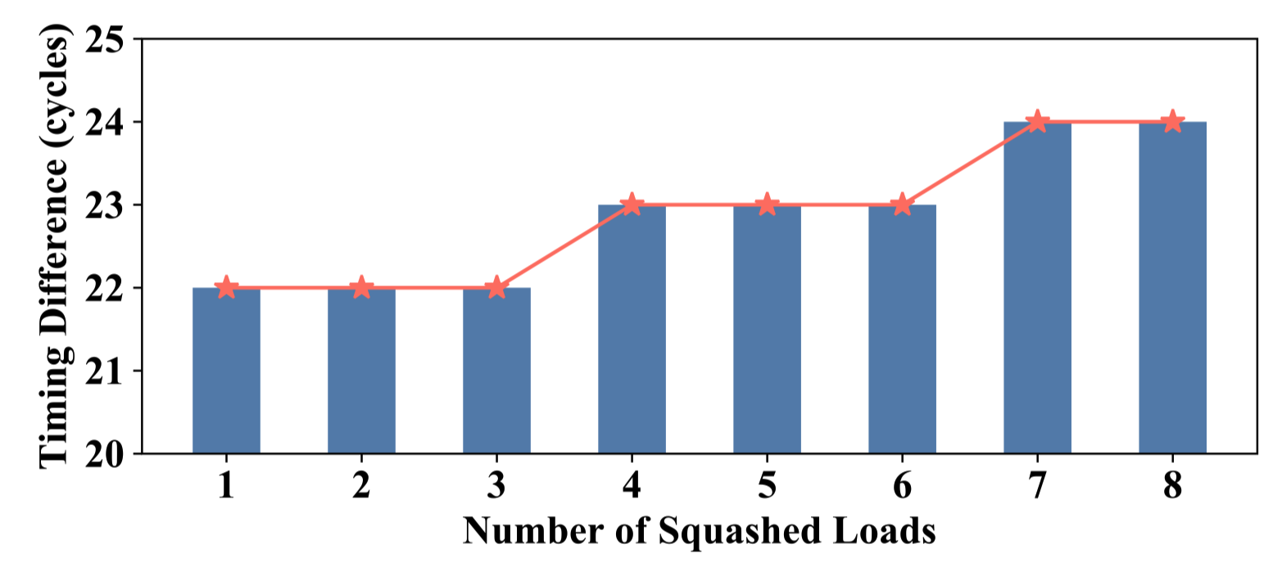
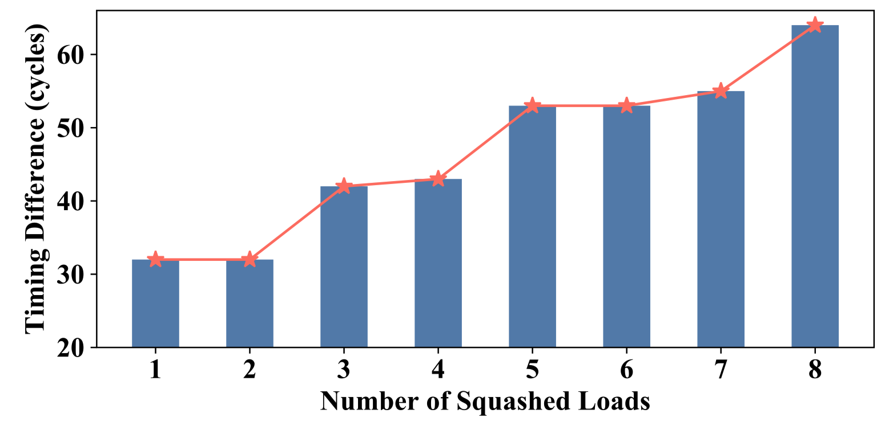
unXpec: How to Encode Secret?
Encode different secret values with different amounts of invalidation and restoration operations being generated during rollback in T5
L1 & L2 invalidation
L1 restoration + L1 & L2 invalidation
Notes:
Our experimental results demonstrate that the rollback time under different secret value is distinguishable. The left figure show the CleanupSpec takes about 22 cycles to invalidate the transient line installs in L1 and L2 cache. After the L1 restoration is invoked, the timing different is increased to about 30 cycles to 60 cycles.

Slide 15

unXpec: Challenge
The attacker can easily measure T1 - T6, instead of directly measuring T5
?
if(index < f(N)) {
secret = A[index];
load(&P[secret * 64 * 1]);
load(&P[secret * 64 * 2]);
...
load(&P[secret * 64 * n]);
}
Notes:
The source of timing difference is originated from T5. However, the attacker has no way directly measuring the T5. He can only observe the latency from T1 to T6. So, the people might ask, is there a way to accurately obtain the timing information about T5 through observing the entire timeline?

Slide 16
unXpec: Solution - Overview
if(index < f(N)) {
secret = A[index];
load(&P[secret * 64 * 1]);
load(&P[secret * 64 * 2]);
...
load(&P[secret * 64 * n]);
}
Notes:
Let me introduce our solution.

Slide 17
unXpec: Solution - Overview
1
memory_fence;
if(index < f(N)) {
secret = A[index];
load(&P[secret * 64 * 1]);
load(&P[secret * 64 * 2]);
...
load(&P[secret * 64 * n]);
}
Notes:
First, we insert a memory fence instruction prior to the timing instruction. This can eliminate the effect of T4 throughout the timeline.

Slide 18
unXpec: Solution - Overview
2
modulate f(N)
1
memory_fence;
if(index < f(N)) {
secret = A[index];
load(&P[secret * 64 * 1]);
load(&P[secret * 64 * 2]);
...
load(&P[secret * 64 * n]);
}
Notes:
Second, by modulating the complexity of f(N), we can make sure all the transient loads in the branch finish loading the block. This can eliminate the T3.

Slide 19
unXpec: Solution - Overview
2
modulate f(N)
1
memory_fence;
if(index < f(N)) {
secret = A[index];
load(&P[secret * 64 * 1]);
load(&P[secret * 64 * 2]);
...
load(&P[secret * 64 * n]);
}
3
independent of secret
Notes:
Now, there remains T1 to T2 and T5 to T6. Although we are unable to eliminate the T1 and T2 from this timeline, we observe that the time period from T1 to T2 is independent of secret value. In other word, whether the secret value is 0 or 1, the time of T1 to T2 is same and will not influence the timing difference observed by the attacker.

Slide 20
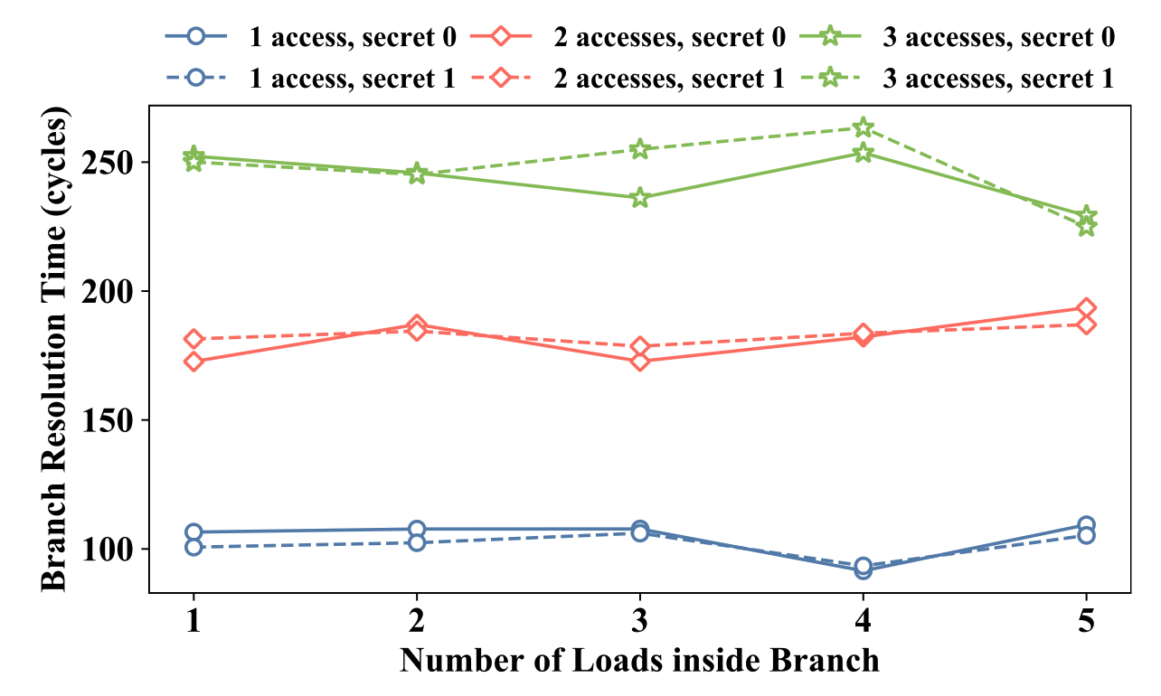
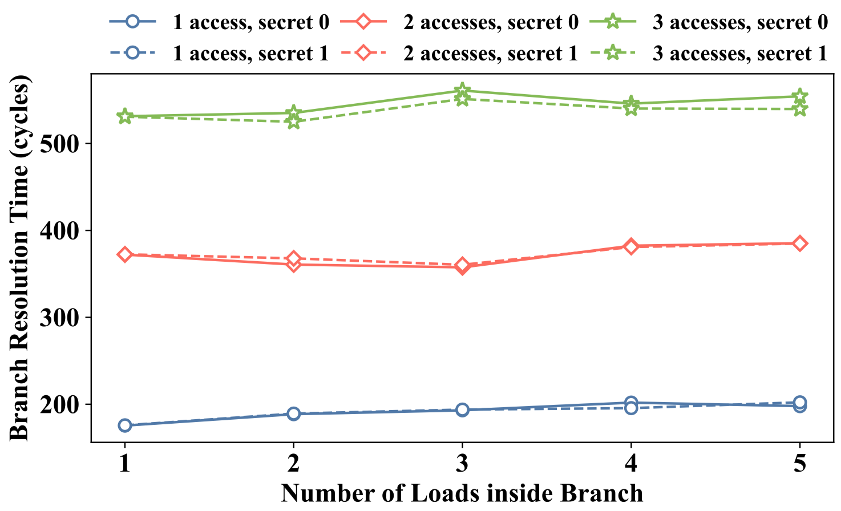
Constant Branch Resolution Time
Simulator: gem5
Commercial CPU: Intel i7-8550U
Notes:
We further validate this conclusion in the gem5 and the commercial processor Intel i7-8550U. We find that the time of T1 to T2 aka branch resolution time is only dependent on the f(N), independent of the secret value. It can be approximated as a constant when the f(N) is fixed.

Slide 21
unXpec: Design
Notes:
We combine the these three solutions and design the unXpec. There are two stages in each round of attack. In the preparation stage, the receiver mistrains the branch predictor and prepare the cache states. The essential goal for such preparation is that the sender program under secret 0 yields all-hits of P[0] and the sender program under secret 1 yields all-misses of P[64 ∗ 1]...P[64 ∗ n]. In the measurement stage, the sender executes the memory fence instruction first. Then, by timing the gadget executed by the sender, the receiver can infer the value of the transmitted secret.

Slide 22
unXpec: Optimization
In preparation stage, prime the cache sets where P[64 * 1]…P[64 * n] locate in the L1 cache with eviction set
Increase timing difference to L1 restoration + L1 & L2 invalidation
Notes:
When the L1 cache is not warmed up, the code shown in the last slide only exploit the timing difference originated from the L1 & L2 invalidation. To optimize the unXpec and increase the observed timing difference, the eviction set is utilized. In the preparation stage, the receiver can employ the eviction set to prime the cache sets where P[64 * 1]…P[64 * n] locate in the L1 cache. This makes the transient loads in the branch deﬁnitely evict some original line and thus induce the L1 cache to restore the evicted lines during cleanup operations. We can leverage the enlarged timing difference against background noise and yield a higher attack resolution.

Slide 23
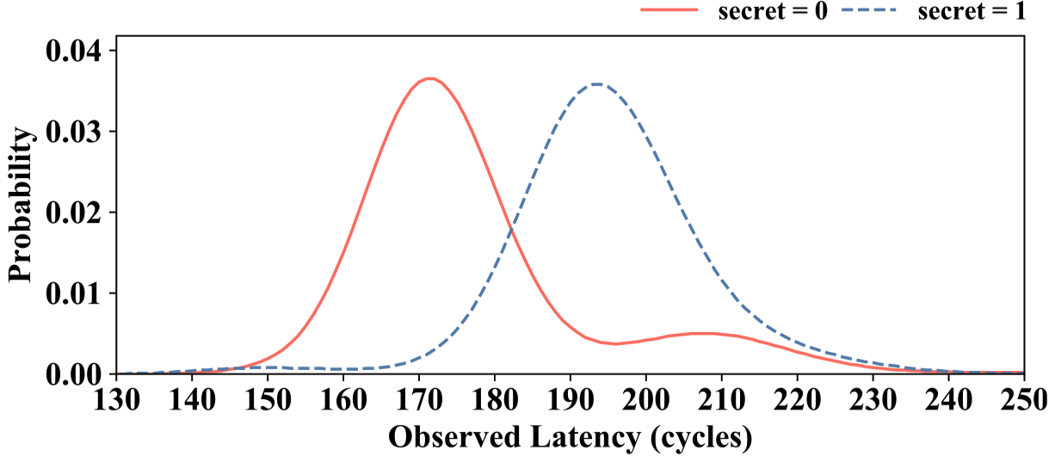
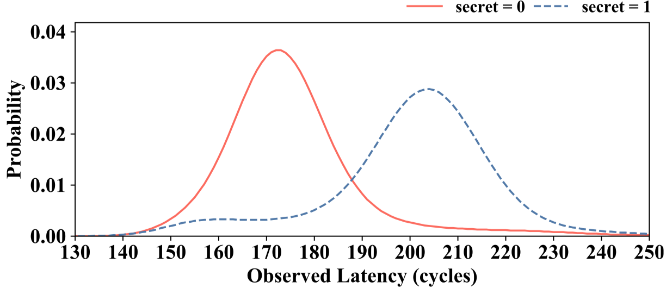
unXpec: Evaluation – Timing Difference
Primary Version – 22 cycles
Using Eviction Sets – 32 cycles
Notes:
We did a series of experiments to evaluate the unXpec. We validate the feasibility of unXpec by measuring secret-dependent timing differences. It demonstrates an average timing difference of 22 cycles and 32 cycles given only a single load in the branch without and with using eviction sets, respectively.

Slide 24
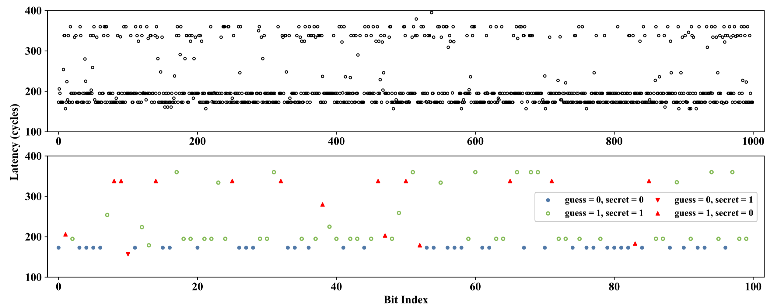
unXpec: Evaluation – Secret Leakage
Notes:
Then, we randomly generate 1,000 secret bits and implement a Meltdown-alike proof-of-concept attack to demonstrate the effectiveness of both unXpec attacks.. The result shows that the attacker can achieve the accuracy of 86.7 percent without using the eviction set.

Slide 25
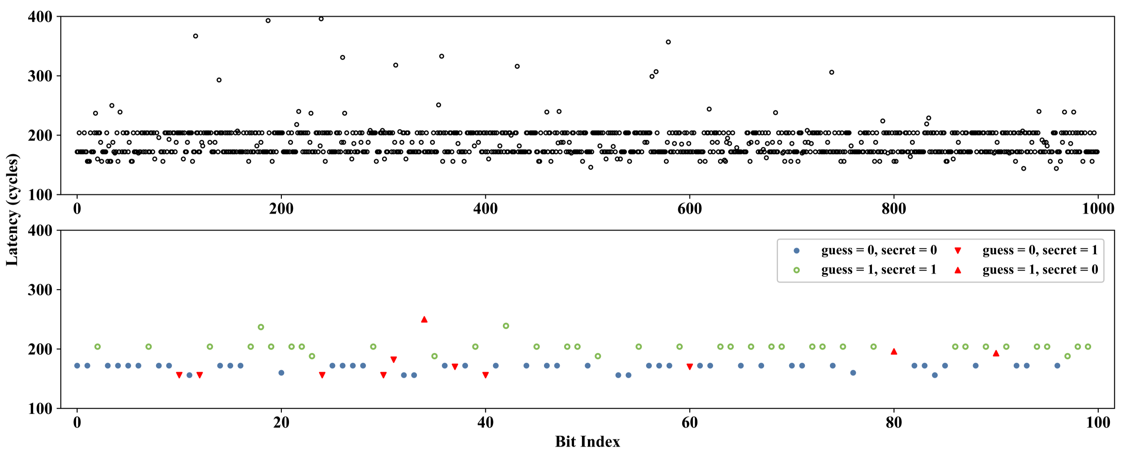
unXpec: Evaluation – Secret Leakage
Notes:
Leveraging eviction sets, unXpec can obtain a larger secret-dependent timing difference. This makes the secret guessing process less susceptible to background noise and thus increases attack accuracy. As shown in this figure, unXpec using eviction sets correctly guesses 916 bits, yielding a much higher accuracy of 91.6%.

Slide 26
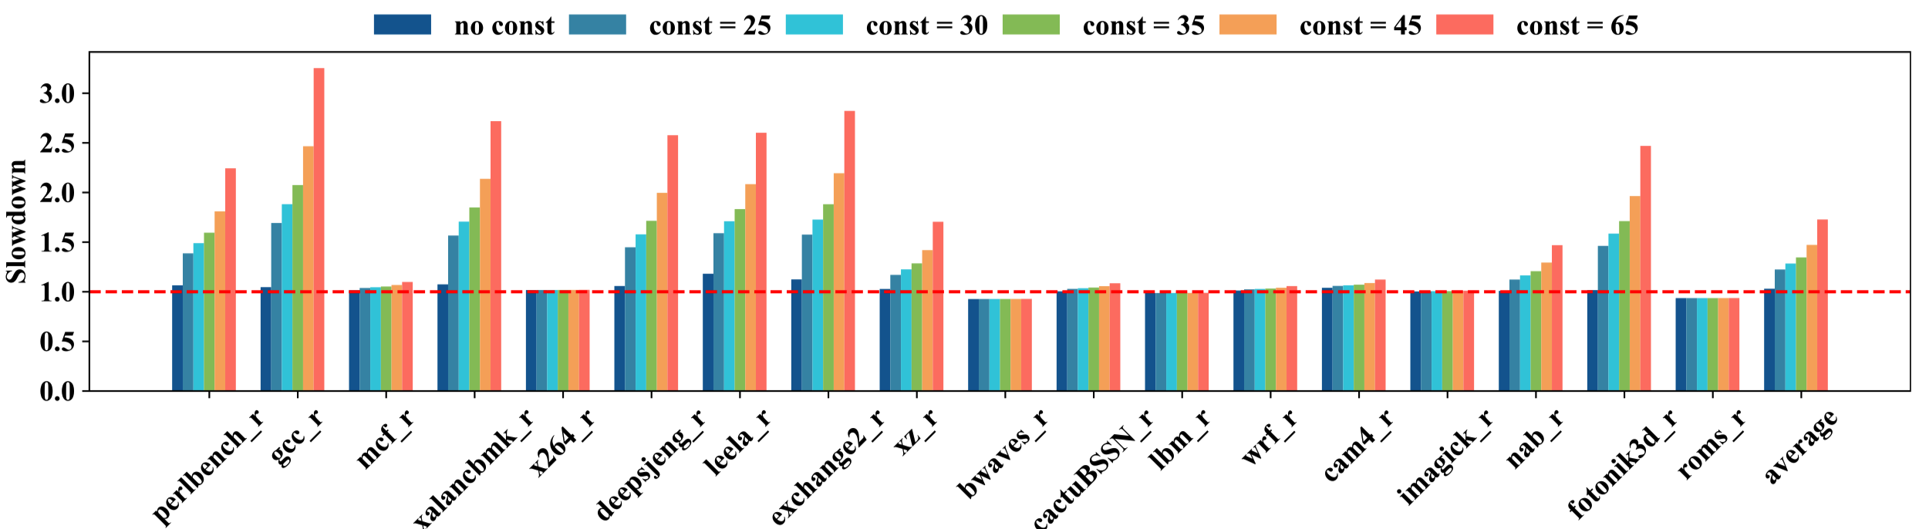
unXpec: Evaluation – Potential Mitigation
Simply enforcing constant-time rollback incurs significant overhead
Notes:
Finally, we evaluate performance overhead of a potential unXpec countermeasure, which enforces constant rollback time for undo schemes. We set the lower bound for the rollback time. Even if the CPU ﬁnishes the cleanup operations ahead of schedule or no cleanup operation takes place at all when transient instructions have not modiﬁed cache states, the CPU should still be stalled until the pre-deﬁned constant time elapses. According to the rollback-timing difference that can be measured by the attacker with or without eviction sets, we evaluate CleaupSpec with constant rollback time ranging from 25 cycles to 65 cycles. The results show that simply enforcing constant-time rollback incurs the overhead ranging from 22.4% with 25-cycle constant rollback time to 72.8% with 65-cycle constant rollback time.
They are both unacceptable.

Slide 27

Conclusion
unXpec is the first attack against Undo-based safe speculation
Calls for either a more efficient countermeasure or a more robust safe speculation
We publish unXpec artifact as well as guidelines for result reproduction:
  https://doi.org/10.5281/zenodo.5771649 (Artifact Appendix)
  https://github.com/RISEGp/unXpec
Notes:
We make the conclusions. unXpec is the first attack against Undo-based safe speculation. Instead of simply enforcing the constant-time rollback to defend against it, our experimental results suggest a more robust safe speculation scheme. We publish the unXpec source code as well as guidelines for result reproduction. You can access the following url or scan the QR code for more information.

Slide 28
Thanks
Mengming Li is seeking for a research intern or PhD position about security in CPU and microarchitecture
If your group has openings or you have any question about this paper, feel free to contact: mmli@zju.edu.cn
This presentation and recording belong to the authors. No distribution is allowed without the authors‘ permission.
Notes:
Thanks….

