Slide 1

Symphony: Path Validation at Scale
Anxiao He, Jiandong Fu, Kai Bu, Ruiqi Zhou, Chenlu Miao, Kui Ren

Slide 2
Background: Packet Forwarding Security
Potential attack surfaces
Traffic diversion
Attacker eavesdrops any parts of packets with potentially sensitive information
Fictitious premium path usage
ISPs use inferior path but charge for premium path
Packet injection with spoofed source address
Routers inject extra packets to incriminate source

Slide 3
Background: Packet Forwarding Security
Potential attack surfaces
Root causes
End hosts have no control over the paths that their packets take
End hosts have no verification of the actual path a packet took toward recipient

Slide 4
Background: Path Validation
Path validation
Control
Select an intended path for a specific packet
Verification
Check if a packet traversed routers on its intended path in the correct order
Notes:
Path validation can be divided into two parts: path control and verification.
Path control enables client to select an intended path for a specific packet.
Path verification lets end hosts can check if packets followed intended path in correct order.

Slide 5
Background: Path Validation
Representative solutions
ICING (CoNEXT 2011)
Each router computes proofs for all its downstream routers and verifies the proofs of all its upstream routers
Notes:
Path validation can be divided into two parts: path control and verification.
Path control enables client to select an intended path for a specific packet.
Path verification lets end hosts can check if packets followed intended path in correct order.

Slide 6
Background: Path Validation
Representative solutions
ICING (CoNEXT 2011)
Each router computes proofs for all its downstream routers and verifies the proofs of all its upstream routers
OPT (SIGCOMM 2014)
Assume a trusted source that pre-computes all the proofs for each node; routers only need to verify and update corresponding proofs
Notes:
Path validation can be divided into two parts: path control and verification.
Path control enables client to select an intended path for a specific packet.
Path verification lets end hosts can check if packets followed intended path in correct order.

Slide 7
Background: Path Validation
Representative solutions
ICING (CoNEXT 2011)
Each router computes proofs for all its downstream routers and verifies the proofs of all its upstream routers
OPT (SIGCOMM 2014)
Assume a trusted source that pre-computes all the proofs for each node; routers only need to verify and update corresponding proofs
EPIC (USENIX Security 2020)
Following OPT, simplify computation and shorten proof size
Notes:
Path validation can be divided into two parts: path control and verification.
Path control enables client to select an intended path for a specific packet.
Path verification lets end hosts can check if packets followed intended path in correct order.

Slide 8
Dilemma between Efficiency and Security
Design dilemma
Proofs should be easy to compute for high efficiency
Proofs should be sufficiently secure to withstand attacks
Efficiency barrier
There exists an inevitable lower bound of overhead for performing secure path validation
Notes:
We observe that existing path validation solutions suffer a dilemma of efficiency and security.
The efficiency requirements asks that proofs should be easy to compute for higher efficiency
The security requirements asks that proofs should be complicated so that they are secure enough to withstand attacks
This results in a core issue. That there exists an inevitable lower bound of overhead for performing secure path validation.

Slide 9
Dilemma between Efficiency and Security
Design dilemma
Proofs should be easy to compute for high efficiency
Proofs should be sufficiently secure to withstand attacks
Efficiency barrier
There exists an inevitable lower bound of overhead for performing secure path validation
Root cause
Packet-wise validation
Notes:
All this is due to the usage of packet-wise validation

Slide 10
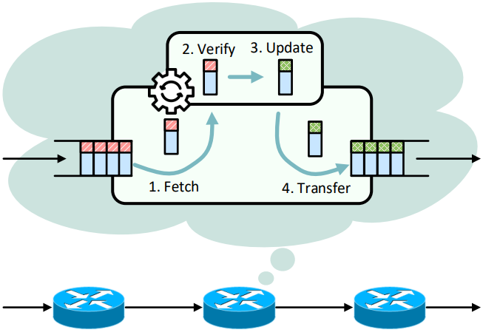
Packet-wise Validation
Centered on individual packets
Process a single packet at a time
Constrained by cryptographic techniques
Limit efficiency and security directly because of the adopted cryptographic scheme
Notes:
Traditional path validation solutions use packet-wise validation.
It focuses on individual packet. For example, in the right-side path validation example, operations of verification and update target only a single packet.
Such limitations make us to think

Slide 11
What if we verify a group of packets simultaneously?
Improve efficiency
Guarantee security
…
Notes:
What if we verify a group of packets simultaneously?

Slide 12
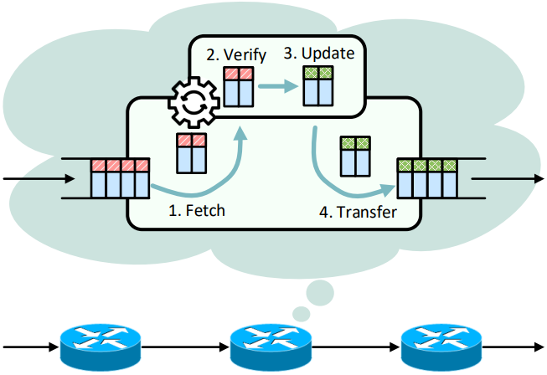
Symphony: Aggregate Validation
Aggregate a group of packets as an independent packet
Amortize the proof and the computation cost evenly over packets
Assure unchanged security constraints through aggregate validation
routers process packets in a group-wise way
Notes:
Thus, we propose Symphony, the first aggregate validation solution.
It processes packets in a group-wise way.
By aggregating a group of packets as an independent packet, Symphony can amoirtize the proof and the computation cost evenly over packets
and assure unchanged security constraints.

Slide 13
Symphony: Aggregate Validation
The router fetches a group of packets from the input queue
The router validates the entire group by comparing the computed proof with concatenated proofs in packets
If validation succeeds, the router updates and evenly distributes its proof across all packets in the group
The router transfers the updated packet group for output
Notes:
Specifically, the workflow of Symphony can be divided into four steps.
first, the router fetches a group of packets from the input queue.
second, the router takes the entire group as an input to compute proofs. Then it extracts the carried proofs and concatenates them. The router validates the entire group by comparing the computed proof with concatenated proofs in packets.
third, the router updates the proof with its own credentials and distribute the proof to all packets
finally, the router places the group in the output queue

Slide 14
How to Identify Packet Order
Hierarchical Tags
Notes:
One challenge is that how we identify packet order

Slide 15
How to Identify Packet Order
Hierarchical Tags
Group Tag
Assign packets of the same group with an identical group tag
Combine SessionID to differentiate groups
Notes:
One challenge is that how we identify packet order

Slide 16
How to Identify Packet Order
Hierarchical Tags
Group Tag
Order Tag
Assign packets of the same group with different order tags
Notes:
One challenge is that how we identify packet order

Slide 17
How to Identify Packet Order
Hierarchical Tags
Group Tag
Order Tag
Group Size
Instruct the exact number of packets in a group
Identify packet loss
Make group size adjustable
Notes:
One challenge is that how we identify packet order

Slide 18
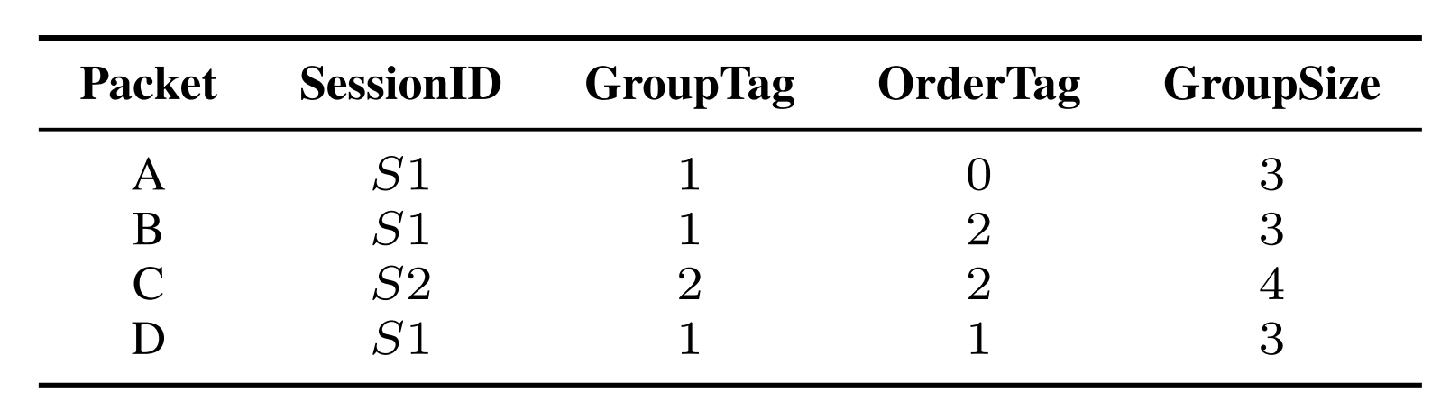
How to Identify Packet Order
Hierarchical Tags
Group Tag
Order Tag
Group Size
Notes:
Here is an example about how we use hierarchical tags to identify packets.

Slide 19
How to Identify Packet Order
Hierarchical Tags
Group Tag
Order Tag
Group Size
Queue 1: packet A
Notes:
Here is an example about how we use hierarchical tags to identify packets.

Slide 20
How to Identify Packet Order
Hierarchical Tags
Group Tag
Order Tag
Group Size
Queue 1: packet A, packet B
Notes:
Here is an example about how we use hierarchical tags to identify packets.

Slide 21
How to Identify Packet Order
Hierarchical Tags
Group Tag
Order Tag
Group Size
Queue 1: packet A, packet B
Queue 2: packet C
Notes:
Here is an example about how we use hierarchical tags to identify packets.

Slide 22
How to Identify Packet Order
Hierarchical Tags
Group Tag
Order Tag
Group Size
Queue 1: packet A, packet D, packet B
Queue 2: packet C
Notes:
Here is an example about how we use hierarchical tags to identify packets.

Slide 23
How to Deal with Packet Loss
Straightforward solution: simply drop all the incomplete groups
The evaluation results show that Symphony still has a higher throughput comparing with EPIC when packet loss rate is up to 10%

Slide 24
How to Deal with Packet Loss
Straightforward solution: simply drop all the incomplete groups
Packet reaggregation: re-initiate aggregation validation over the remaining packets

Slide 25
How to Deal with Packet Loss
Straightforward solution: simply drop all the incomplete groups
Packet reaggregation: re-initiate aggregation validation over the remaining packets
Embed an entire proof seed
The seed is carried by all packets in a group
Routers can use the seed to compute a valid proof

Slide 26
How to Deal with Packet Loss
Straightforward solution: simply drop all the incomplete groups
Packet reaggregation: re-initiate aggregation validation over the remaining packets
Embed an entire proof seed
Verify the remaining packets
Routers compare the computed proof with the remaining segments of proofs

Slide 27
How to Deal with Packet Loss
Straightforward solution: simply drop all the incomplete groups
Packet reaggregation: re-initiate aggregation validation over the remaining packets
Embed an entire proof seed
Verify the remaining packets
Generate new proofs to replace the originals
Routers use the left packets as an input to compute new path validation proofs

Slide 28
How to Deal with Packet Loss
Straightforward solution: simply drop all the incomplete groups
Packet reaggregation: re-initiate aggregation validation over the remaining packets
Embed an entire proof seed
Verify the remaining packets
Generate new proofs to replace the originals
Update a source-generated ciphertext
  Routers use their own keys to update the encrypted packet message
  Prevent packets from being modified by malicious routers

Slide 29
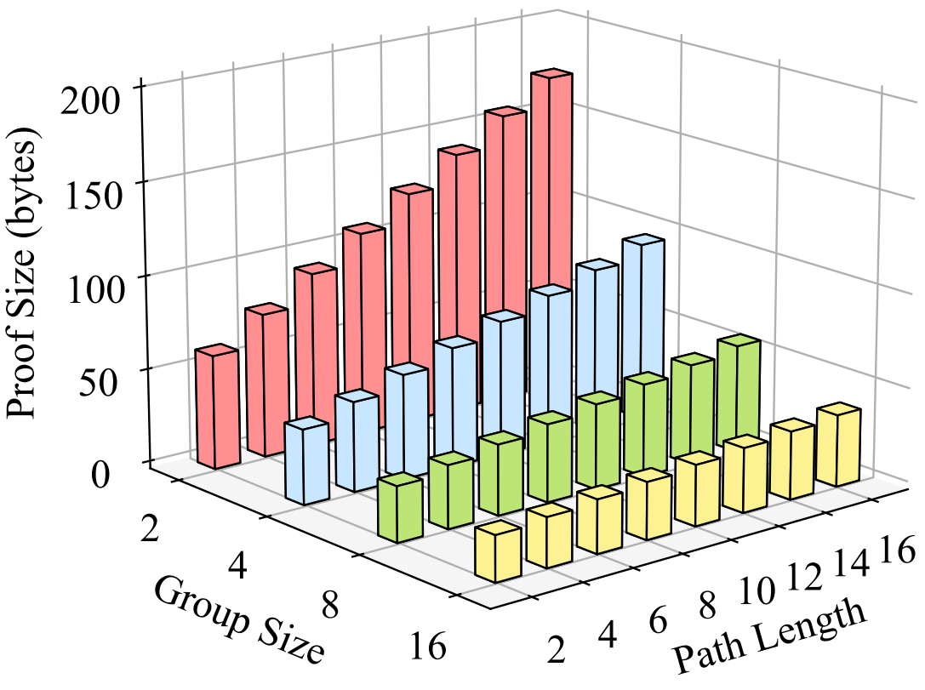
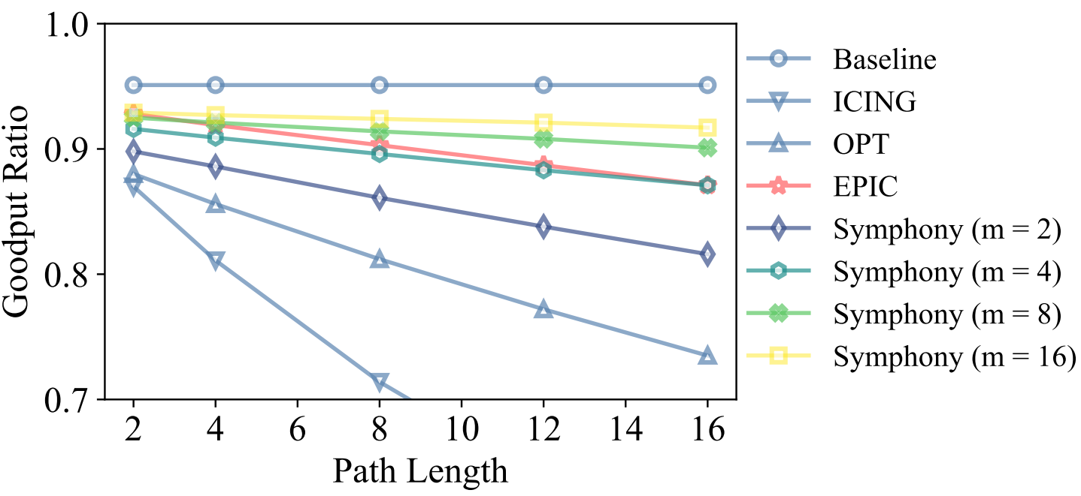
Evaluation: Low Communication Overhead
Symphony increases 5% goodput ratio in comparison with EPIC
Notes:
EPIC: 86.51%
Symphony: 91.72%

Slide 30
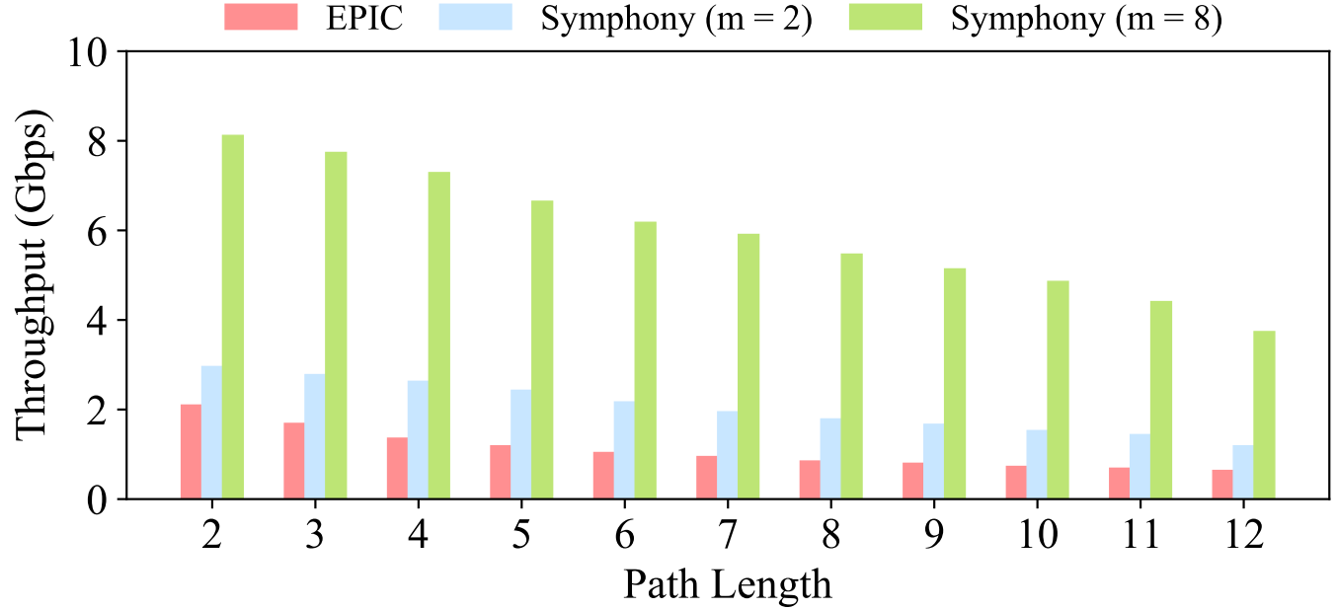
Evaluation: High Efficiency
Symphony achieves 1.41$×$~5.84$×$ higher throughput than EPIC does
Notes:
implemented on 14 servers

Slide 31
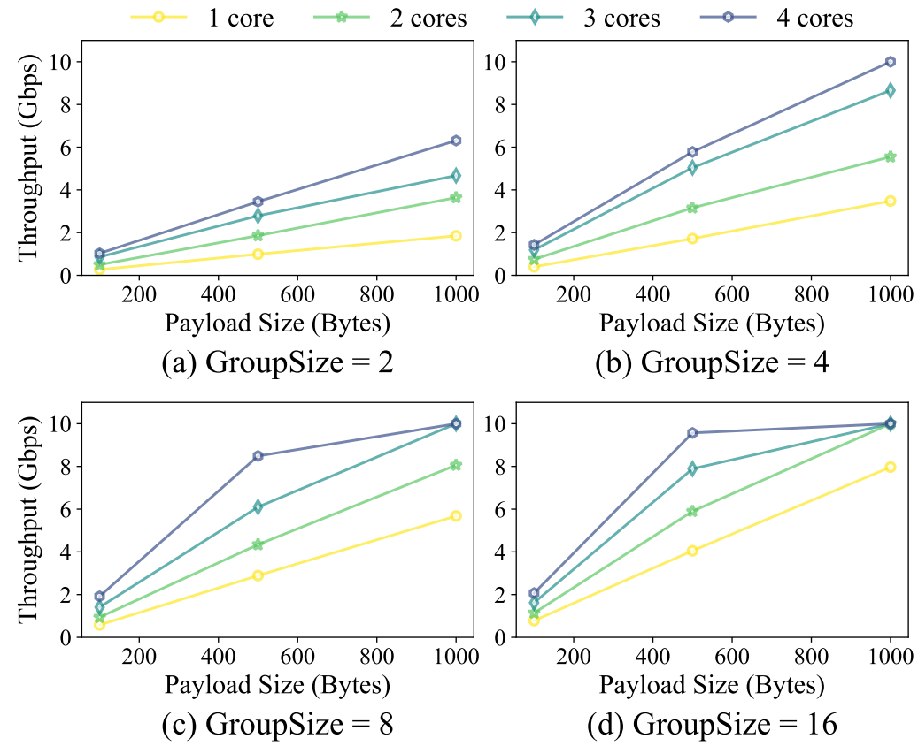
Evaluation: High Parallelizability
Symphony reaches the upper bound of 10 Gbps link using 3 cores

Slide 32
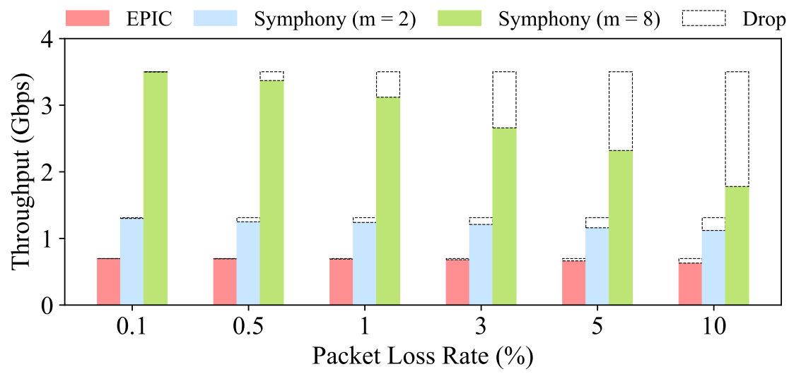
Evaluation: Resistance to Packet Loss
Symphony outperforms EPIC with a 1.5$×$ higher throughput
Notes:
TCP BBR model

Slide 33
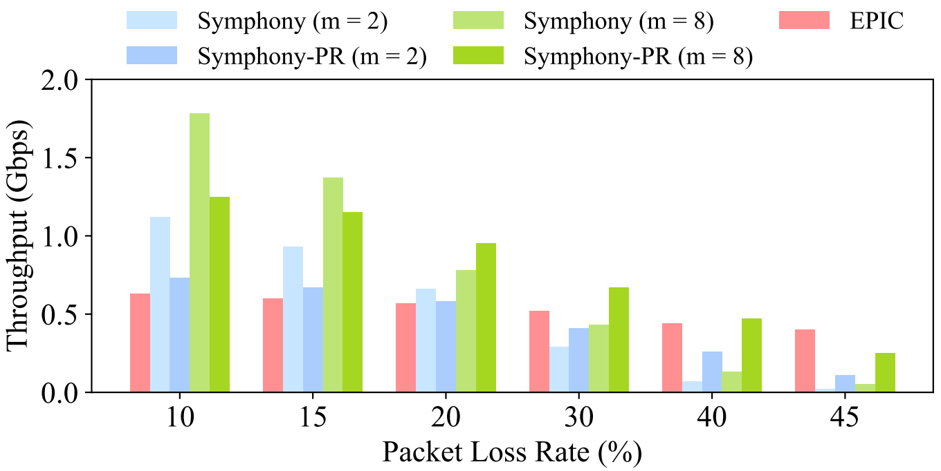
Evaluation: Resistance to Packet Loss
Symphony-PR yields a 5$×$ higher throughput than Symphony does given a 45% packet loss rate

Slide 34
More in Paper
Security analysis
Proof unforgeability
Hop-wise validation
DDoS resistance
Performance evaluation
Proof processing time
Reassembly time
Reordering time
Mixed packet size

Slide 35
Conclusion
We amortize validation overhead to improve efficiency yet without sacrificing security
We propose various techniques to achieve correct and efficient packet aggregation and implement them through Symphony
We further propose a packet reaggregation technique to efficiently handle packet losses and integrate it into Symphony-PR

Slide 36
Thanks!
If you have any questions about this paper,
welcome to contact zjuhax@zju.edu.cn

