Slide 1
SwiftDir: Secure Cache Coherence without Overprotection
MICRO 2022
Chenlu Miao, Kai Bu, Mengming Li, Shaowu Mao*, Jianwei Jia*
Zhejiang University, *Huawei Technologies

Slide 2
Background: Cache Coherence Protocols
MSI Coherence Protocol
MESI Coherence Protocol
Exclusive State
Accelerate write-after-read accesses!
Notes:
Cache coherence should be preserved on any multicore system such that different cores can access the same value for the same memory location.
In this paper, We focus mainly on directory-based coherence protocols as modern processors often adopt this design
The MSI protocol is seminal and all coherence protocols deployed on modern multicore chips inherit its three states—Modified, Shared, and Invalid
To optimize MSI protocol, The MESI protocol introduces an Exclusive state to make the S state more fine-grained and save coherence traffic.
So, Why the introduction of E state could be an optimization?
The E state helps accelerate write-after-read accesses [46], [65].
With E state, the cache knows it’s the only owner of the block, so it can write the cache line without notifying other cores.
However, Without the E state, MSI marks a clean data block with the S state. To serve a subsequent write request targeting the S-state block, the core needs to request ownership. This triggers further invalidation commands to other cores for avoiding potential stale copies.

Slide 3
Background: Coherence-based Timing Channel
E-state coherence request
S-state coherence request
core A
core B
core C
core A
core B
core C
E
X
S
X
S
X
❶
❸
❷
❶
❷
Directory
E
X
S
X
Directory
❶ Core A request directory for memory location X
❶ Core A requests Directory for memory location X
❷ Directory forwards request to Core B
❷ LLC sends response to Core B
❸ Core B sends response to Core A
Notes:
However, the optimization of E state brings security vulnerabilities: there is a coherence-based timing channel
it arises from different access latencies for fetching data blocks in E state and S state upon a cache miss.
Here we present the process to access an E-state or S-state block for memory location X in the LLC.
Firstly E state.
Since Core A has no copy of data in iits private caches, it sends a request to the directory (step 1).
The directory finds that the X-addressed data block is exclusively cached on core B.
Although the LLC also has a copy for X, the E state makes the directory hard to ensure whether the value in the LLC is obsolete. Therefore, the directory forwards the request to the owner—Core B (step 2). Upon receiving the forwarded request, Core B responds Core A with data.
In contrast, when the requested data block is in the S state , the directory ensures that the copy in the LLC holds the same value with that of other copies cached in some core’s private caches.
The directory thus more quickly returns the requested data block from the LLC.

Slide 4
Background: Covert-channel Attack
Attack Model:
The sender and receiver first construct shared memory by directly calling a shared library or indirectly leveraging memory deduplication.
The sender aims to leak secrets by modulating the secret through coherence states (i.e., E and S) of shared data.
The sender can create threads on different cores
The receiver can decode secrets through the E/S timing channel
[HPCA’18] Are Coherence Protocol States Vulnerable to Information Leakage?
Notes:
Leveraging this timing difference, researches propose a covert channel attack
First Let’s see the attack model.
It employs two colluding processes—sender and receiver on a multicore processor.
The attack requires shared memory. The sender and receiver first construct shared memory by calling a shared library or leveraging memory deduplication
The sender leaks secrets by coherence states of shared data and it has the ability to create threads on different cores.
The receiver can decode secret through the timing channel

Slide 5
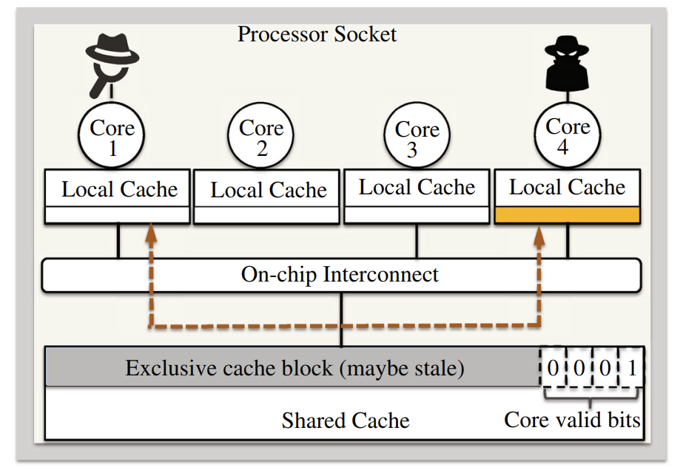
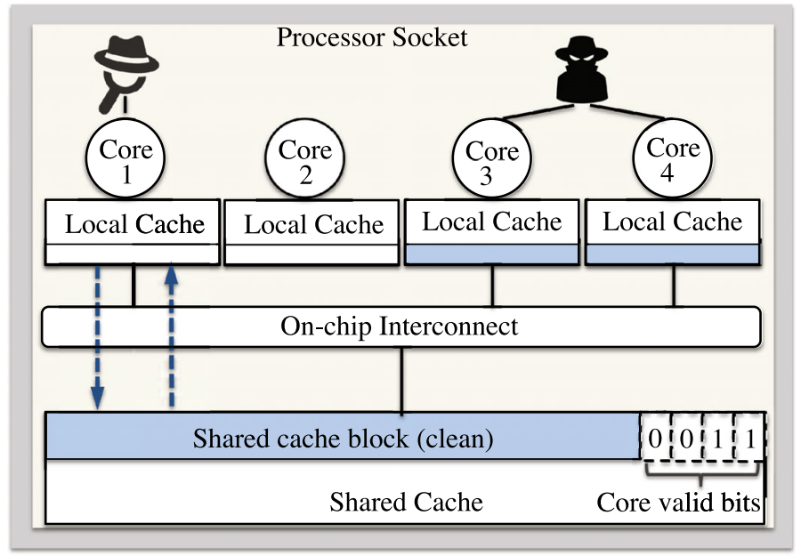
Background: Covert-channel Attack
[HPCA’18] Are Coherence Protocol States Vulnerable to Information Leakage?
Notes:
The sender and receiver may agree to transmit bit 1 via E-state memory location X and bit 0 via S-state X.
To place X in the E state, the sender can create a thread on one core to initiate a cold-start access to X.
To place X in the S state, the sender can create two threads on two cores; both threads then access X.
When the receiver accesses X, it measures the access latency and identifies sate E or S given a slow or fast access, respectively and thus decode secrets.

Slide 6
Background: S-MESI
1. write X
2b. transition
4. transition
Private
Cache
M
E
X
X
X
EM^{A}
2a. upgrade
3a. ack
3b. transition
LLC
Directory
E
X
Directory
M
X
Notes:
To defend against this attack, the state-of-the-art countermeasure, we name it S-MESI, returns the requestd data in both states E and S from the LLC
However, this nullifies the silent upgrade effect from E to M that the E state is supposed to offer.
When traditional silent upgrade updates the E-state block in private caches into state M, its corresponding copy in the LLC stays in state E.
Directly returning E-state data from the LLC likely results in accessing stale data.
Therefore, SMESI revokes silent upgrade and enforces the M state to be synchronized across both private caches and the LLC.
Let’s see the process
Upon receiving a write request for a private data block in state E (step 1)
the core sends a coherence request to the LLC for privilege upgrade (step 2a) and transits state E to a transient EMA state (step 2b).
It then waits for the LLC’s acknowledgement (step 3a)
The acknowledgement from the LLC triggers private caches to update the EMA state to the M state

Slide 7
SwiftDir: Overview
Performance
E state
Security
Downgrade E state
Notes:
The state-of-the-art S-MESI traps in an intrinsic dilemma where performance and security are deemed contradictory [66].
The introduction of state E brings better performance at the cost of vulnerability [65].
To regain security, it seems that we have to degrade the E state with performance sacrifice.

Slide 8
SwiftDir: Overview
We observe that
The coherence attack exploits only shared data.
S-MESI nullifies state E and complicates the E→M transition for all data.
So SwiftDir
Shrink protection scope to exploitable shared data which is actually write-protected.
Remove their redudant E state from coherence.
Notes:
We observe that the inevitable overhead by nullifying the E state arises from overprotection.
Since the coherence attack exploits only shared data, protecting only shared data is sufficient.
However, S-MESI nullifies state E and complicates the E→M transition for unshared data.
We are motivated to minimize the protection scope.
We find that exploitable shared data belong to write-protected data, whose E state is redundant.
We can simply remove their E state from coherence to fundamentally throttle the exploited E/S timing difference.

Slide 9
SwiftDir: Overview
Performance
E state
Security
SwiftDir
Notes:
SwiftDir enforces protection over only write-protected data by serving all requests toward them directly from the LLC with a constant latency.
This not only simplifies how MESI handles write-protected data but also avoids how S-MESI overprotects them.
Meanwhile, SwiftDir still preserves silent upgrade for efficient handling of unshared data.
We think SwiftDir can gain performance and security at the same time

Slide 10
SwiftDir: Design
Identification of Shared Memory
Argumentation of Sharing Status
Modification of Coherence Protocol
Notes:
Toward minimizing the scope of protection to only exploitable shared data, the ultimate goal is to enable a coherence protocol to identify shared data and hide the timing
difference from their accesses in E and S states. We highlight
three major design strategies for our SwiftDir to achieve the goal.
First of all, we need to identify shared memory
Then, in order to transmit the information to the cache coherence protocol, we need to augment sharing status
And finally, modify the coherence protocol

Slide 11
SwiftDir: Design
Identification of Shared Memory
Exploited Shared Memory is Write-protected
Write-protected Manifests in PTE R/W Field
Argumentation of Sharing Status
Modification of Coherence Protocol
Notes:
We leverage the MMU to identify exploitable shared memory
It’s based on two observations.
First, we find that exploited shared memory is write-protected.
The coherence attack generates shared memory in two ways, first by using shared library, and the second by using memory deduplication. They are all write-protected.
Then, we find that write-protected manifests in page table entry’s read/write field.

Slide 12
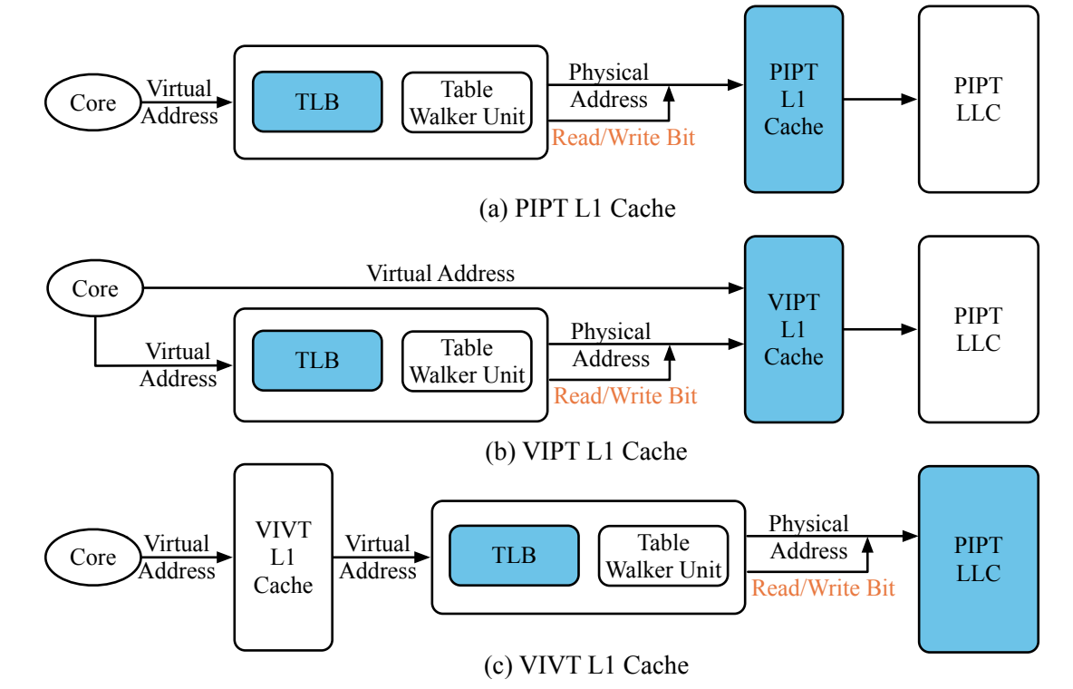
SwiftDir: Design
Identification of Shared Memory
Argumentation of Sharing Status
PIPT/VIPT/VIVT L1
Modification of Coherence Protocol
Notes:
With the write-protected information, next SwiftDir hitchhikes address translation to transmit the write-protected information from the MMU to the cache hierarchy for coherence maintenance.
Different cache architectures lead to respective complexities to this hitchhiking method.
VIVT, for example. It allows the core to send a virtual address to the L1 cache even prior to address translation. To address such a concern, we thoroughly investigate all the three cache architectures in commercial use—PIPT, VIPT, and VIVT
We find that SwfitDir suffices for the LLC to obtain the write-protected information of the requested data until the request arrives at the LLC. This requirement can be easily satisfied regardless of cache architecture, simply because that the LLC is a physical cache and address translation should have taken place before accessing the LLC

Slide 13
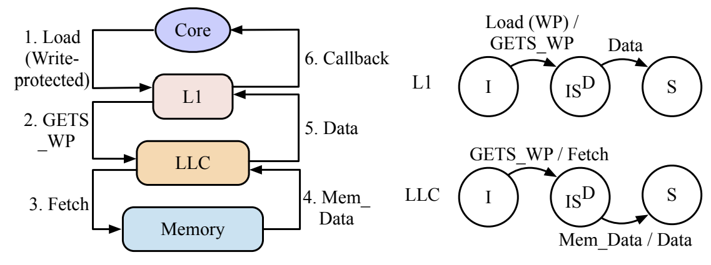
SwiftDir: Design
Identification of Shared Memory
Argumentation of Sharing Status
Modification of Coherence Protocol
Notes:
Finally, it’s about modification of coherence protocol.
SwiftDir imposes minimum modification on existing coherence protocols by narrowing down the protection scope to only write-protected data
Motivated by the observation that write-protected data are not supposed to be written, we consider it less necessary to maintain their E state.
SwiftDir thus directly sets an initial load of write-protected data in the S state instead of the E state
This way, write-protected data no longer transit to the E state and are immune from timing-channel attacks

Slide 14
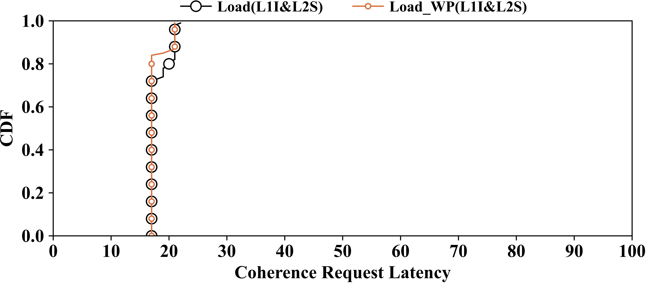
Evaluation – Security
Notes:
We did a series of experiments to evaluate the SwiftDir.
First for security issue, We measure the access latency of traditionally vulnerable shared data to show that SwiftDir successfully prevents the timing channel
This figure reports the cumulative distribution function (CDF) of Load WP(L1I&L2S) by SwiftDir, in comparison with that of Load(L1I&L2S) by MESI.
It can been seen that it leaves the attacker with no timing difference to exploit.

Slide 15
Evaluation – Single-Threading Performance
Notes:
We start performance evaluation with the single-threaded benchmarks in the SPEC CPU 2017 suite.
SwiftDir outperforms both MESI and SMESI in terms of most single-threaded SPEC benchmarks. It yields a 0.03% higher IPC and a 0.01% higher IPC on average than do MESI and S-MESI, respectively.

Slide 16
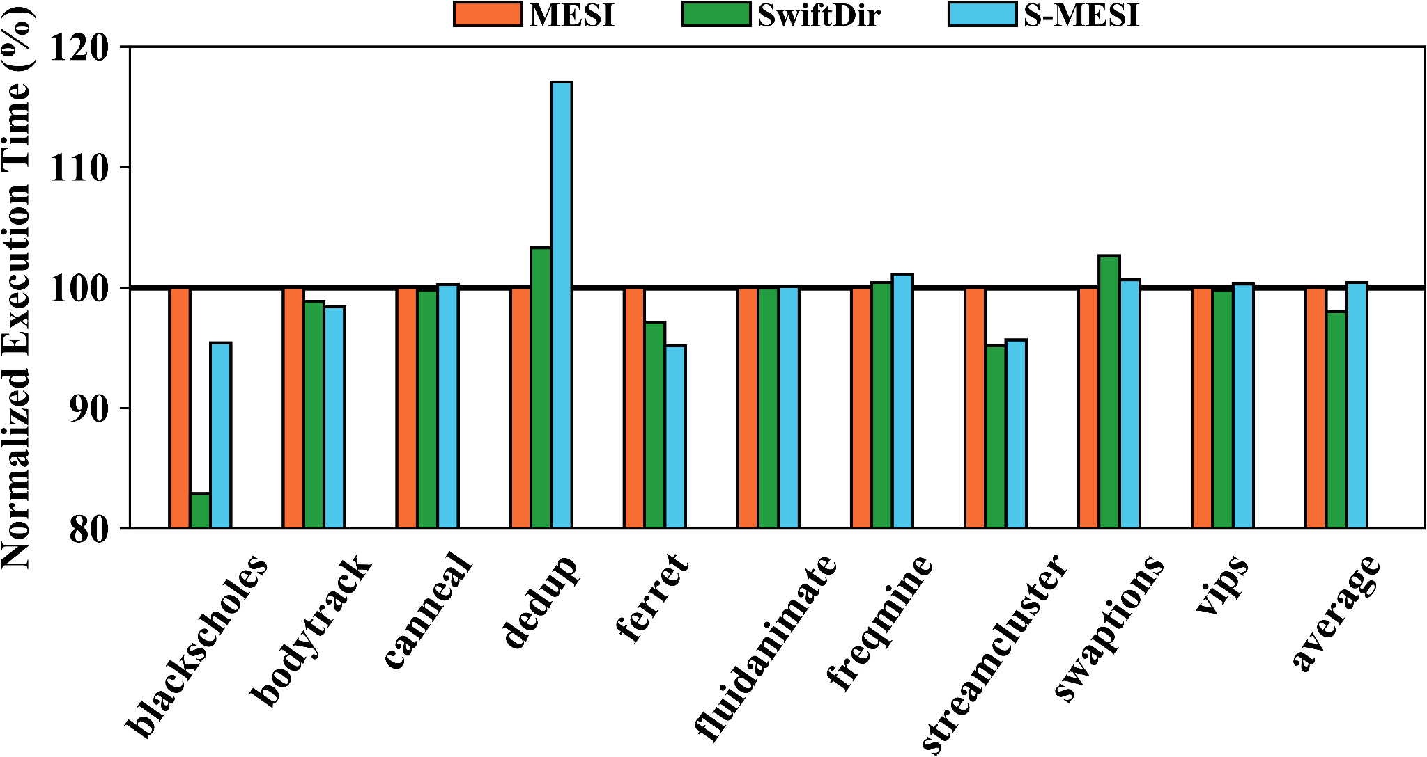
Evaluation – Multi-Threading Performance
Notes:
We then evaluate SwiftDir performance using the multithreaded benchmarks in the PARSEC 3.0 benchmark suite.
On a 4-core processor, each benchmark spawns four threads to accelerate Region of interest execution.
On average, SwiftDir outperforms both MESI and S-MESI with a 2.01% and 2.31% shorter execution time, respectively

Slide 17
More in the paper
The side-channel attack
Performance evaluation on
Amount of shared data
Write-after-read intensive applications
Notes:
You can find more information in our paper

Slide 18
Conclusion
SwiftDir is the first attempt to secure cache coherence with performance gains.
This promises a way of protection by simplification rather than complication.
Notes:
We make the conclusion:
SwiftDir is the first attempt to secure cache coherence with performance gains.
This promises a way of protection by simplification rather than complication.

Slide 19
Thanks
If your have any question about this paper, feel free to contact: clmiao@zju.edu.cn
Notes:
Thanks

